Slide 1
RL-LLM Based Co-evolving Multi-generational Red-team and Blue-team AI Agents in a Cyber Range
Student: Aniket Aggarwal
Advisor: Professor Ying-Dar Lin , Professor Yuan Cheng Lai
High Speed Network Lab
National Yang Ming Chiao Tung University, Taiwan
Notes:
We need a Blue Team to detect and respond to Red Team activities.
And for the Blue Team to be more effective, it’s better to equip it with AI capabilities so it can better recognize Red Team behavior.
However, to acknowledge advance threats blue team should evolve — from its first generation into later generations — with each version outperforming the previous one.
but How do we improve the Blue Team AI?
So To improve the Blue Team AI, we need to use Red Team AI — an attacker that challenges it.the Blue Team AI must train against a Red Team AI until either:
It consistently beats the Red Team so with time the Blue Team learns to detect them.
but the problem is if the Red Team doesn’t improve, the Blue Team will stagnate.
We need both sides to grow together.so we will now use the new gen of blue team to train red time ai.
The Red Team gets better at attacking, and the Blue Team gets better at defending.
How does this training happen?
We begin with initial versions of each:
We fix the Red Team and train the Blue Team until it beats the Red Team 95% of the time. At that point, the Blue Team “graduates” to its next generation say from b0 to b1.
Then we fix that new Blue Team b1 and train the Red Team r0 until it can bypass its defenses most of the time. That Red Team then becomes the next generation r0 to r1.
This back-and-forth continues:
Red trains Blue → stronger Blue.
Blue trains Red → stronger Red.
And so on — creating a continuous arms race where both sides improve through competition.
Since cyber attacks are multi-step and sequential. The Red Agent uses Reinforcement Learning (RL) to learn how to build complete attack chains (lifecycles) over time. RL helps it maximize long-term success — by chaining the right techniques from initial access to final impact. Once the Red Agent selects the best sequence, a Language Model (LLM) generates the actual attack payloads and script variations for execution.
The Blue Agent also uses RL to learn how to detect and stop these attacks at the right step. It observes raw logs and traffic, and uses an LLM to map them to likely MITRE techniques. RL then helps the agent choose the best defense actions across episodes. This enables the Blue Agent to adapt over time, even as the Red Agent evolves and changes strategies.
To train an AI Blue Team capable of defeating all variants of Red Team strategies — across evolving threat landscapes.

Slide 2
Outline
Motivation
Background
Adversarial Roles in Cybersecurity
Agentic AI in Offensive and
Defensive Security
MITRE ATT&CK
MITRE Engage
Reinforcement Learning
Related works
AI-Based Red-Blue Teaming
Issues
Notations
Problem Statement
Solution
Overview
Blue Agent Process
Red Agent Process
Implementation
Evaluation
Schedule
References
2

Slide 3
Motivation
Why AI Based Red/Blue Team?
Human simulation → Costly, slow, expert-dependent
AI agents → Scalable, fast, repeatable cyber exercises
Automates both attack (Red) & defense (Blue)
Why Co-evolve Red and Blue Agents?
Static Blue agent → Overfit to outdated attacks
RL-based Red ↔ RL-based Blue evolve together → Adaptive, robust strategies
Adaptive attacker & defender agents → Scalable, autonomous, and continuously improving
Why RL-based?
Cyber kill chains → Sequential + Multi-stage decision problems
RL → Learns optimal attack/defense over time beyond rule-based or heuristic systems.
3
Notes:
Critical Infrastructure at Risk: Industrial systems like power grids and water treatment plants face sophisticated threats. Traditional methods can fall short when attackers use zero-day or advanced tactics specifically designed for ICS environments.
Shortcomings of Existing Security: While IDS and static honeypots work in IT contexts, ICS attackers can detect and evade these simpler decoys. Current ICS honeypots exist, but many are static, offering limited engagement and realism.
ICS/OT vs. IT: ICS protocols are not like typical IT protocols; they are often proprietary, binary, and real-time. This difference demands a more specialized honeypot approach. Some ICS-targeted honeypots do exist, but most lack adaptive, learning-based deception techniques.
Need for Innovative Defense: An RL-driven honeypot can dynamically respond to attacker behavior, prolong engagement, and provide deeper insight into attacker tactics. This addresses the unique ICS vulnerabilities and helps defenders stay a step ahead.

Slide 4
Background – Cybersecurity Training
Red Team (Attacker Simulation)
Emulates real-world adversaries using offensive tactics and exploits
Tests the organization’s detection and response capabilities
Blue Team (Defender Operations)
Detects, responds to, and mitigates ongoing attacks
Maintains system integrity, logs, alerts, and incident response
4
Notes:
Industrial Control Systems (ICS): ICS includes all the hardware and software (OT + IT) managing critical industrial processes (e.g., power generation, manufacturing). It’s broader than just PLCs—it also involves HMIs, SCADA systems, and the network infrastructure.
Cyber-Physical Systems (CPS): These combine computation with real-world processes in real time. In ICS settings, this means sensors, actuators, and PLCs constantly exchanging data and commands, making the system vulnerable to sophisticated cyber attacks.
Programmable Logic Controllers (PLCs): PLCs execute the control logic that directly manipulates physical equipment. They form the heart of automation in ICS. Because they run specialized code, manipulating or changing this logic can lead to severe physical outcomes.
Common Attacks: Beyond just DoS and MitM, attackers often try to change PLC logic or firmware to gain deeper control or send unauthorized commands. This can disrupt or sabotage industrial operations.

Slide 5
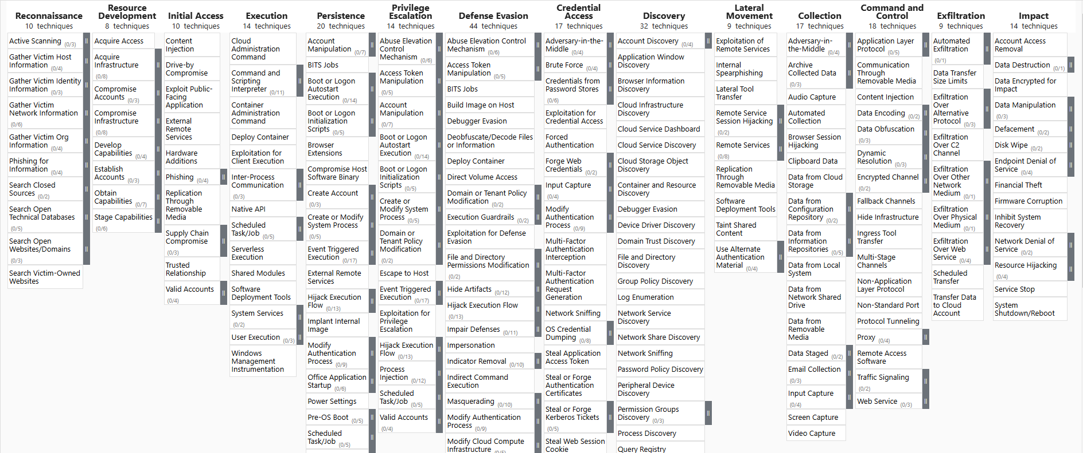
Background – MITRE ATT&CK
MITRE ATT&CK Framework:
Defines attacker Tactics, Techniques, Procedures (TTPs)
Provides structured understanding of attack lifecycle
Lifecycle (kill chain): a sequence of techniques
For Enterprise:
14 tactics,
202 techniques,
435 sub-techniques
MITRE ATT&CK Enterprise
5

Slide 6
Background – MITRE ATT&CK
Focus: Data confidentiality, availability, and business continuity
Characteristics: Modern IT stack, frequent updates, 3–5 year lifecycle
System: Uses standard protocols: HTTP(S), SMB, LDAP, VPN, RDP ; Centralized services: Active Directory, EDR, email, SSO
Adversary Goals : Steal data, disrupt operations, ransom critical services
Important Techniques in Enterprise Attacks:
Credential Dumping (T1003): Extracting user credentials from memory or LSASS
Command and Scripting Interpreter (T1059): Using PowerShell, cmd, or bash for post-exploitation
Domain Trust Abuse (T1484.002): Exploiting AD misconfigurations to move laterally or escalate
Data Encrypted for Impact (T1486): Encrypting files/systems to execute ransomware attacks
6
Notes:
Comprehensive framework

Slide 7






Background – Reinforcement Learning
RL Components
Agent: Learns and makes decisions
Environment: The system the agent interacts with
State ($s_{t}$): Current situation
Action ($a_{t}$): Decision made by the agent
Reward ($r_{t}$): Feedback received
Objective: Maximize cumulative rewards
Received Reward $r_{t}$
Agent
Action $a_{t}$
State $s_{t}$
Next State $s_{t+1}$
Environment
Immediate Reward $r_{t+1}$
Figure. The agent-environment interaction in RL
7

Slide 8
Related work on AI-Based Red-Blue Teaming
Study | Red Team AI | Blue Team AI | RL Algorithm | RL Algorithm (Blue) | Training Method |  |  | Multi-Generation
 |  |  |  |  | Fixed Opponent | Sim. C-Evo | Alt. C-Evo
 |  |  | Red | Blue
[5] | Scripted | LLM + RL | – | PPO | ✓ | – | – | –
[6] | Scripted | RL-based | – | DQN, PPO | ✓ | – | – | –
[3] | RL-based | Scripted | PPO | – | ✓ | – | – | –
[4] | RL-based | Scripted | DQN variants | – | ✓ | – | – | –
[7] | Scripted | RL-based | – | DQN | ✓ | – | – | –
[9] | RL-based | RL-based | PPO, A2C | PPO, A2C | ✓ | ✓ | – | –
MG-CoE (Ours) | RL + LLM | RL + LLM | DDQN | DDQN | ✓ | ✓ | ✓ | ✓
8

Slide 9
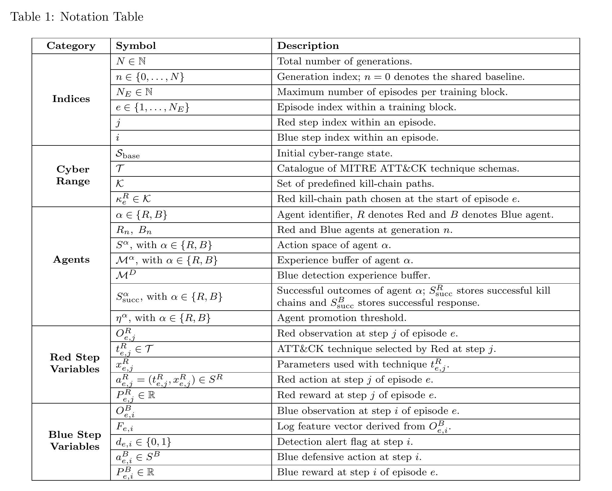
Notations (1/2)
9

Slide 10
Notations (2/2)
10

Slide 11
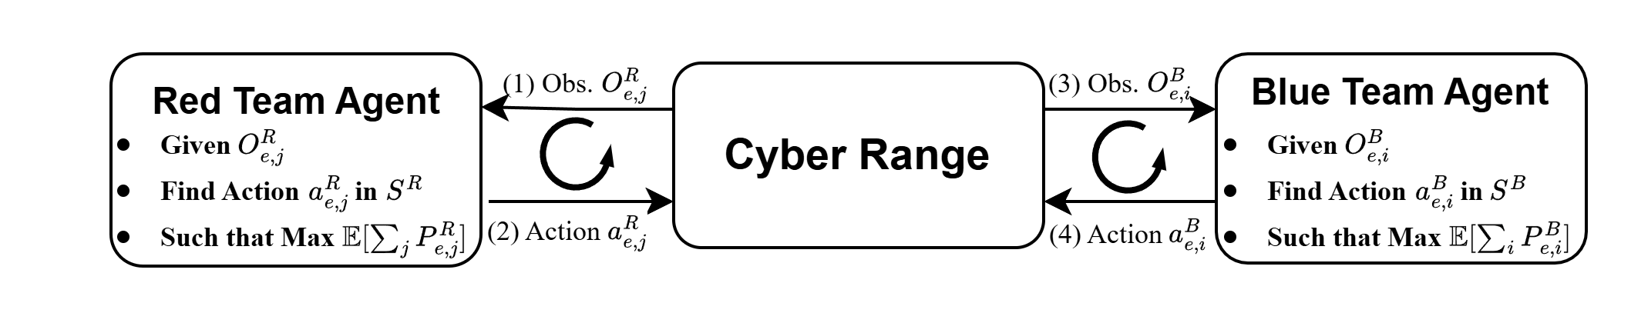
Problem Overview
Red Team Problem: Kill Chain Completion
How do Red Agent move from one technique to the next technique in order to complete the kill chain?
Blue Team Problem: Kill Chain Disruption
How do Blue Agent detect and respond with action to stop the kill chain?
11

Slide 12
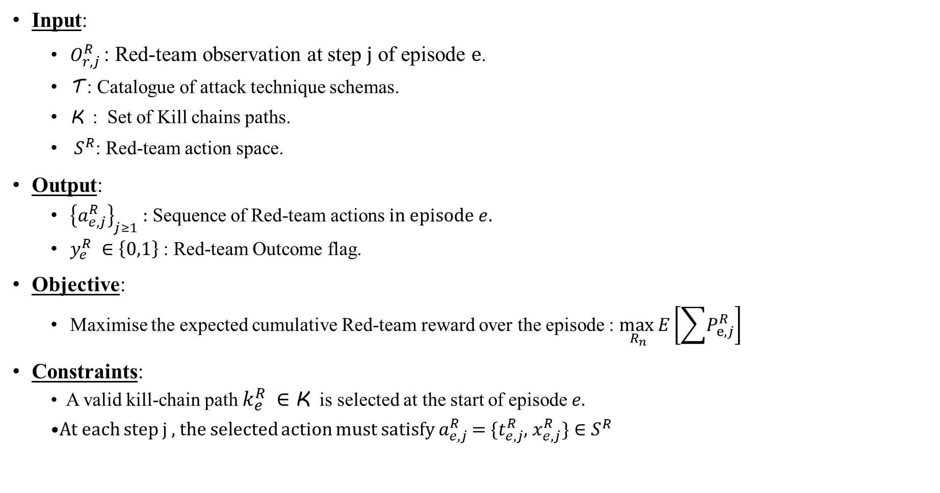
Red Team Problem: Kill Chain Completion
Input:
$O_{r,j}^{R}$ : Red-team observation at step j of episode e.
$\text{T}$ : Catalogue of attack technique schemas.
K : Set of Kill chains paths.
${ S}^{R}$: Red-team action space.
Output:
${\left\{a_{ⅇ,j}^{R}\right\}}_{j≥1}$ : Sequence of Red-team actions in episode$e$.
$y_{ⅇ}^{R} ∈\left\{0,1\right\}$: Red-team Outcome flag.
Objective:
Maximise the expected cumulative Red-team reward over the episode : $\max_{R_{n}}E\left[\sum{P_{ⅇ,j}^{R}}\right]$
Constraints:
A valid kill-chain path $k_{e}^{R} ∈$K is selected at the start of episode $e$.
At each step j , the selected action must satisfy $a_{ⅇ,j}^{R}$ =$\{t_{ⅇ,j}^{R}$, $x_{ⅇ,j}^{R}\}∈S^{R}$
12

Slide 13
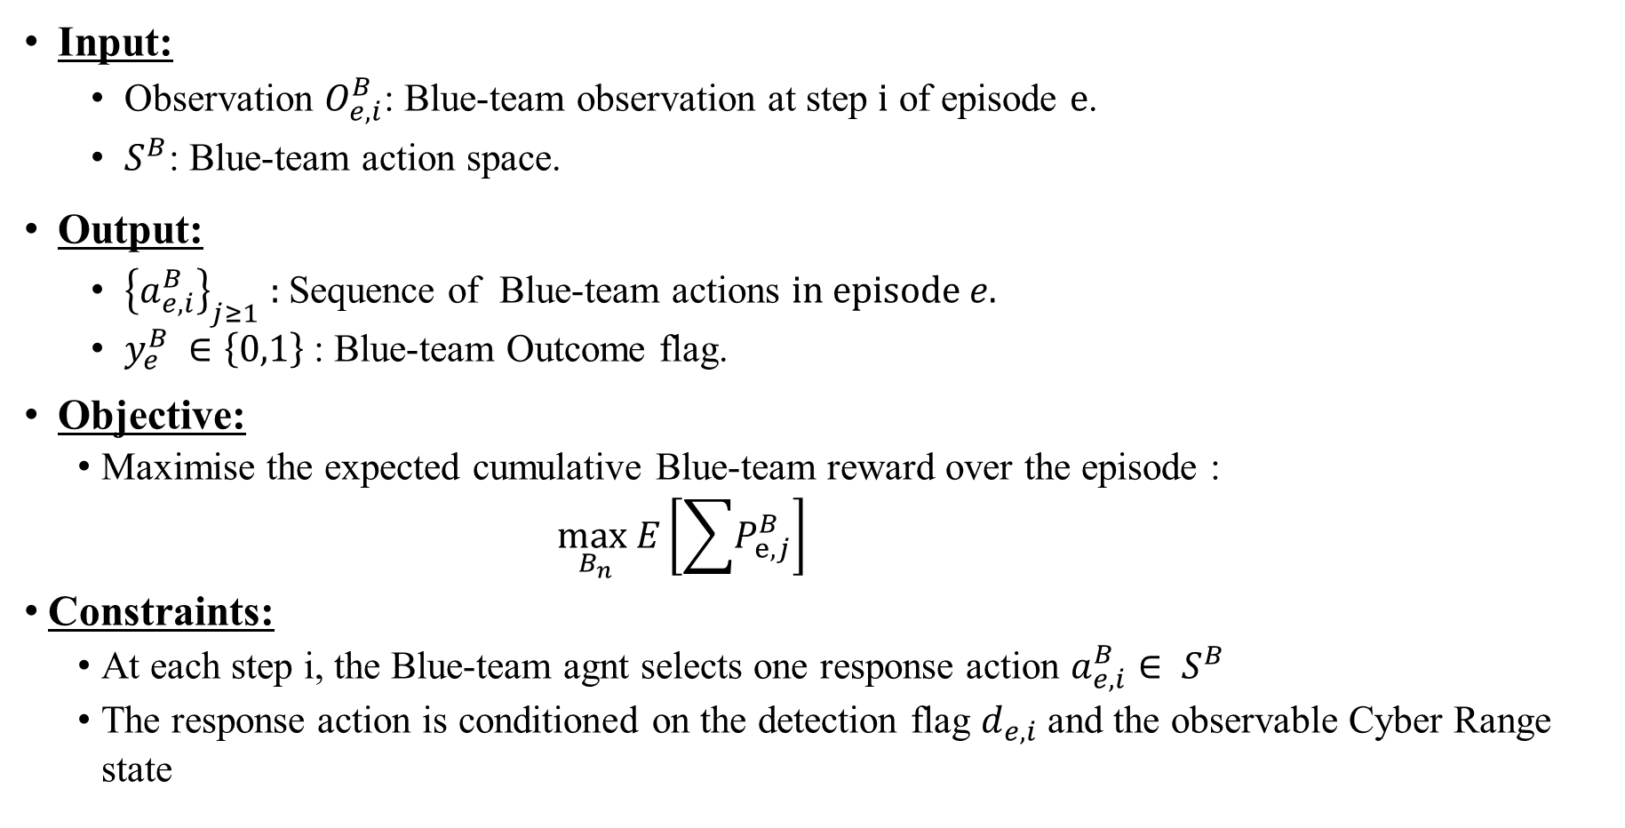
Blue Team Problem: Kill Chain Disruption
Input:
Observation $O_{e,i}^{B}$: Blue-team observation at step i of episode e.
$S^{B}$: Blue-team action space.
Output:
${\left\{a_{ⅇ,i}^{B}\right\}}_{j≥1}$ : Sequence of Blue-team actions in episode$e$.
$y_{ⅇ}^{B} ∈\left\{0,1\right\}$: Blue-team Outcome flag.
Objective:
Maximise the expected cumulative Blue-team reward over the episode :
$\max_{B_{n}}E\left[\sum{P_{ⅇ,j}^{B}}\right]$
Constraints:
At each step i, the Blue-team agnt selects one response action $a_{ⅇ,i}^{B}∈ S^{B}$
The response action is conditioned on the detection flag $d_{e,i}$ and the observable Cyber Range state
13

Slide 14
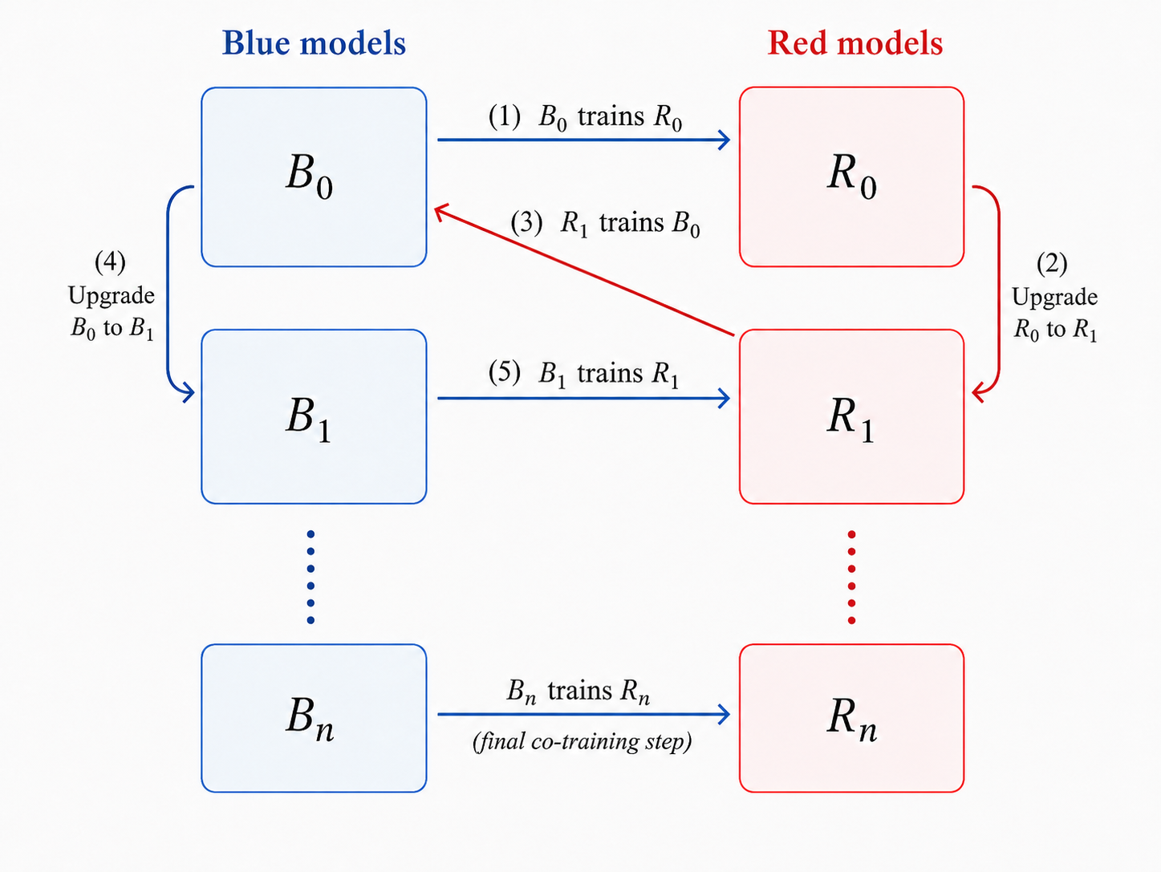
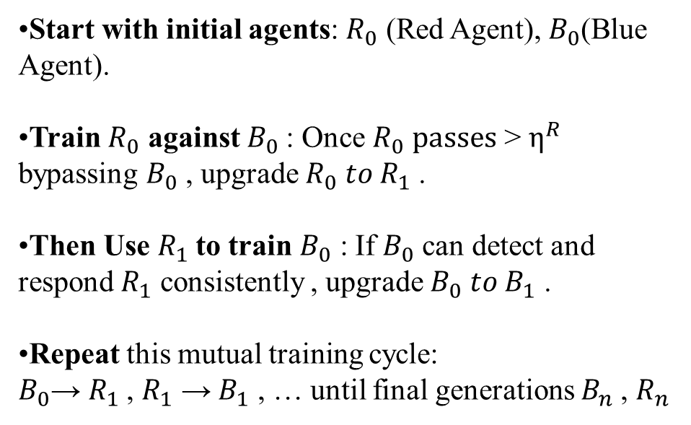
Solution overview
Start with initial agents: $R_{0}$ (Red Agent), $B_{0}$(Blue Agent).
Train $R_{0}$ against $B_{0}$: Once $R_{0} passes$ > $η^{R}$ bypassing $B_{0}$ , upgrade${ R}_{0} to R_{1}$.
Then Use $R_{1}$to train $B_{0}$ : If $B_{0}$ can detect and respond $R_{1}$ consistently , upgrade $B_{0} to B_{1}$ .
Repeat this mutual training cycle: $B_{0}$→ $R_{1}$, $R_{1}$ → $B_{1}$ , … until final generations $B_{n}$, $R_{n}$
14

Slide 15
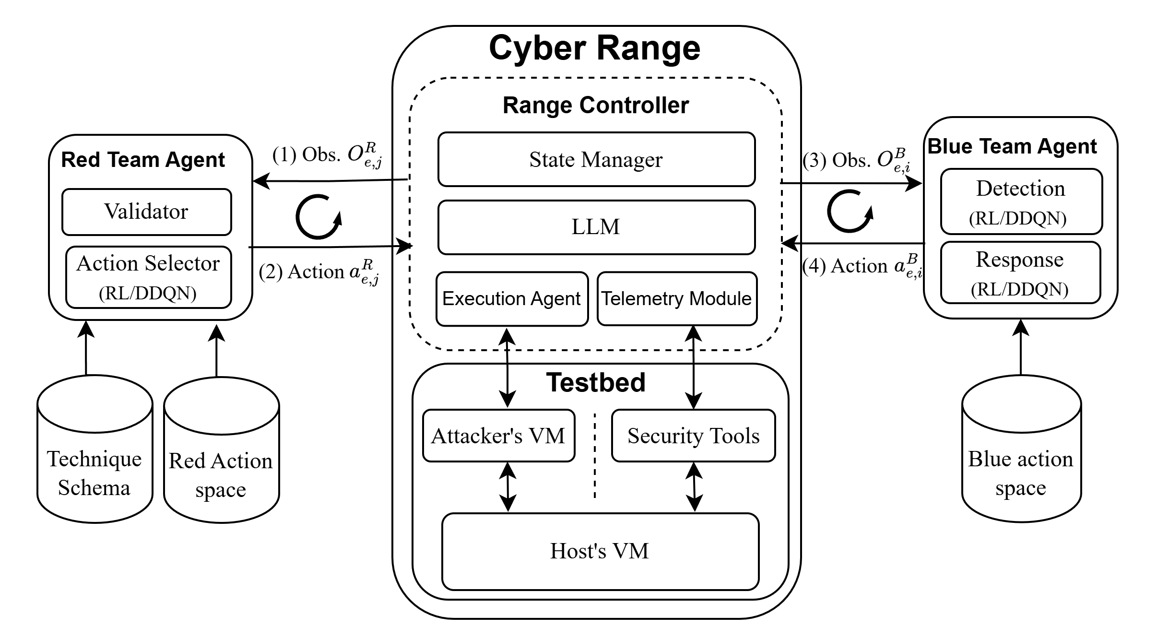
Solution overview
15

Slide 16
Red Team Agent : Action Space
Tactic | No. | Representative techniques
Reconnaissance | 16 | T1595 Active Scanning; T1592 Gather Victim Host Information; T1590 Gather Victim Network Information.
Execution | 16 | T1059.001 PowerShell; T1059.003 Windows Command Shell; T1059.006 Python.
Persistence | 56 | T1098 Account Manipulation; T1547.001 Registry Run Keys; T1053 Scheduled Task/Job.
Privilege Escalation | 33 | T1548.002 Bypass UAC; T1134.001 Token Impersonation; T1543.003 Windows Service.
Defense Evasion | 12 | T1027 Obfuscated Files; T1562 Impair Defenses; T1070 Indicator Removal.
Credential Access | 35 | T1003.001 LSASS Memory; T1555 Credential Stores; T1557.001 SMB Relay.
Discovery | 38 | T1087 Account Discovery; T1046 Network Service Discovery; T1057 Process Discovery.
Lateral Movement | 6 | T1021 Remote Services; T1021.002 SMB/Admin Shares; T1080 Taint Shared Content.
Collection | 18 | T1005 Data from Local System; T1560.001 Archive via Utility; T1113 Screen Capture.
Command and Control | 21 | T1071.001 Web Protocols; T1105 Tool Transfer; T1572 Protocol Tunneling.
Exfiltration | 8 | T1041 Exfiltration over C2; T1048 Alternative Protocol; T1020 Automated Exfiltration.
Impact | 20 | T1485 Data Destruction; T1486 Data Encrypted for Impact; T1561.002 Disk Wipe.
16

Slide 17

Red Team Agent – Technique Schema
technique_id: T1021.002
technique_name: SMB/Windows Admin Shares
tactic: LateralMovement
tool: metasploit
required_state: # Preconditions (must be true in state)
- has_valid_creds
- has_port_445
- os_family == Windows
required_params: # Parameters selected by RL (after preconditions pass)
target_ip:
source: discovered_hosts
credential_id:
source: credential_store
port:
fixed: 445
expected_state_updates: # What the environment updates after execution
on_success:
- session_established = true
- compromised_hosts += target_ip
- new_host_access_level = admin
on_failure:
- failed_lateral_attempts += 1
evidence: # Observable artifacts (logs / signals)
- session_established
- smb_auth_success
- new_process_created
risk: # Risk level for Blue Team detection
detectability: high
Why? Wasted exploration on impossible actions.
The agent selects techniques even if needed conditions (like credentials or open ports) are not met.
Solution- Defines each ATT&CK technique in structured form.
The schema checks whether a selected technique is valid in the current cyber-range observation, so Red cannot execute meaningless actions.
Each technique has a schema with
technique_id
technique_name
tactic
tool
Execution flow: RL selects technique → Validator checks required_state → if valid, RL selects required parameters → Send action to cyber range → execute.
required_state,
required_params,
expected stage change,
evidence, risk
17
Notes:
Critical Infrastructure at Risk: Industrial systems like power grids and water treatment plants face sophisticated threats. Traditional methods can fall short when attackers use zero-day or advanced tactics specifically designed for ICS environments.
Shortcomings of Existing Security: While IDS and static honeypots work in IT contexts, ICS attackers can detect and evade these simpler decoys. Current ICS honeypots exist, but many are static, offering limited engagement and realism.
ICS/OT vs. IT: ICS protocols are not like typical IT protocols; they are often proprietary, binary, and real-time. This difference demands a more specialized honeypot approach. Some ICS-targeted honeypots do exist, but most lack adaptive, learning-based deception techniques.
Need for Innovative Defense: An RL-driven honeypot can dynamically respond to attacker behavior, prolong engagement, and provide deeper insight into attacker tactics. This addresses the unique ICS vulnerabilities and helps defenders stay a step ahead.

Slide 18


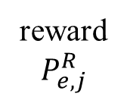



Red Team Agent – Action Selection
Action Selection Process:
Technique selection: choose from $t_{e,j}^{R}$ tactic-matched set ​$k_{e}^{R}$.
Validation: check valid($t_{e,j}^{R}$,$O_{r,j}^{R}$) = 1 before execution.
Parameter resolving: ​assign $x_{e,j}^{R}$ and form $a_{e,j}^{R}=(t_{e,j}^{R},x_{e,j}^{R})$
Goal: Progress through kill chain → Maximize kill chain completion and Reward
Red Team Agent
Technique Selector
(RL/DDQN)
Parameter Selector
(RL/DDQN)
Validator
$$O_{e,j}^{R}$$
Technique Schema
Red Action Space
reward
$$P_{e,j}^{R}$$
$$P_{e,j+1}^{R}$$
Action${ a}_{e,j}^{R}$
Cyber Range
$$O_{e,j+1}^{R}$$
18

Slide 19
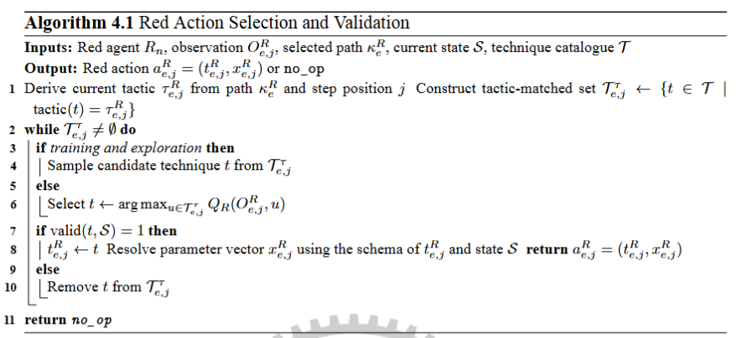
Red Team Agent – Algorithm updates
19

Slide 20
Blue Team Agent : Action Space
Action | Level | Purpose
none | None | No response when evidence is insufficient.
investigate | Low | Gather evidence without changing reachability.
kill_process | Medium | Stop a suspicious process.
force_sign_out | Medium | Terminate active sessions.
revoke_credentials | Medium | Invalidate credentials used by Red.
block_ip | High | Block communication from a host or address.
isolate_host | Hard | Remove the host from reachable interaction.
20

Slide 21


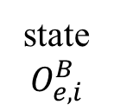

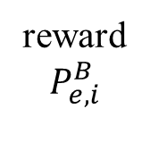





Blue Team Agent: Detection and Response
Detection and Response :
Detection: Blue observes $O_{e,i}^{B}$​ and extracts log features$F_{e,i}.$
Alert decision: Detection module outputs $D_{e,i}$∈{0,1}.
Response: If $D_{e,i}$=1, Blue selects $a_{e,i}^{B}∈S^{B}$ to disrupt Red else $a_{e,i}^{B}=none$.
Goal: Detect multi-stage attacks early in the kill chain, minimizing damage
Blue Team Agent
Detection
$$D_{e,i}$$
$F_{e,i}$, $O_{e,i}^{B}$
Response
$$D_{e,i}=1$$
state
$$O_{e,i}^{B}$$
$$a_{e,i}^{B}=none$$
Blue Action Space
reward
$$P_{e,i}^{B}$$
$$P_{e,i+1}^{B}$$
action $a_{e,i}^{B}$
Cyber Range
$$O_{e,i+1}^{B}$$
21

Slide 22
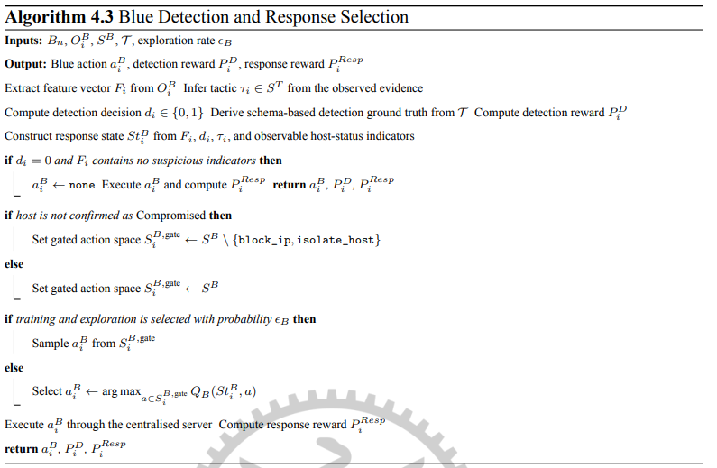
Solution – Blue Agent Algorithm
22

Slide 23
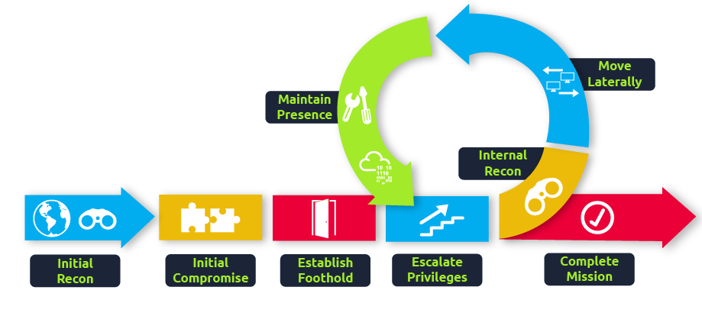
Solution – ATT&CK Graph for Red Team Agent
23

Slide 24
Simulation Execution Loop (Red PAMDP + Blue RL)
Initialize base_state using Recon + LLM
FOR each episode:
Reset state ← base_state
Select kill-chain path and initial target
WHILE tactics remain AND goal not reached:
Select valid technique via Red RL
Execute technique in cyber range
IF detected:
Blue selects defensive action
IF block or isolate:
Reset episode
IF execution successful:
Update state via technique schema
Assign rewards to Red and Blue
IF lateral movement:
Spawn next segment with new target
END WHILE
END FOR
Input:
- base_state_json : initial state vector template (from Recon + LLM)
technique_schemas : {TechniqueSchema} with required_state, required_params, expected_state_updates
MAX_EPISODES
MAX_SELECT_TRIES = 5 // max technique-selection attempts per tactic
MAX_EXEC_FAILS = 5 // max execution failures before episode reset
GOAL_HOST = 192.168.81.131
GOAL_TACTICS = {Impact, Exfiltration}
24

Slide 25
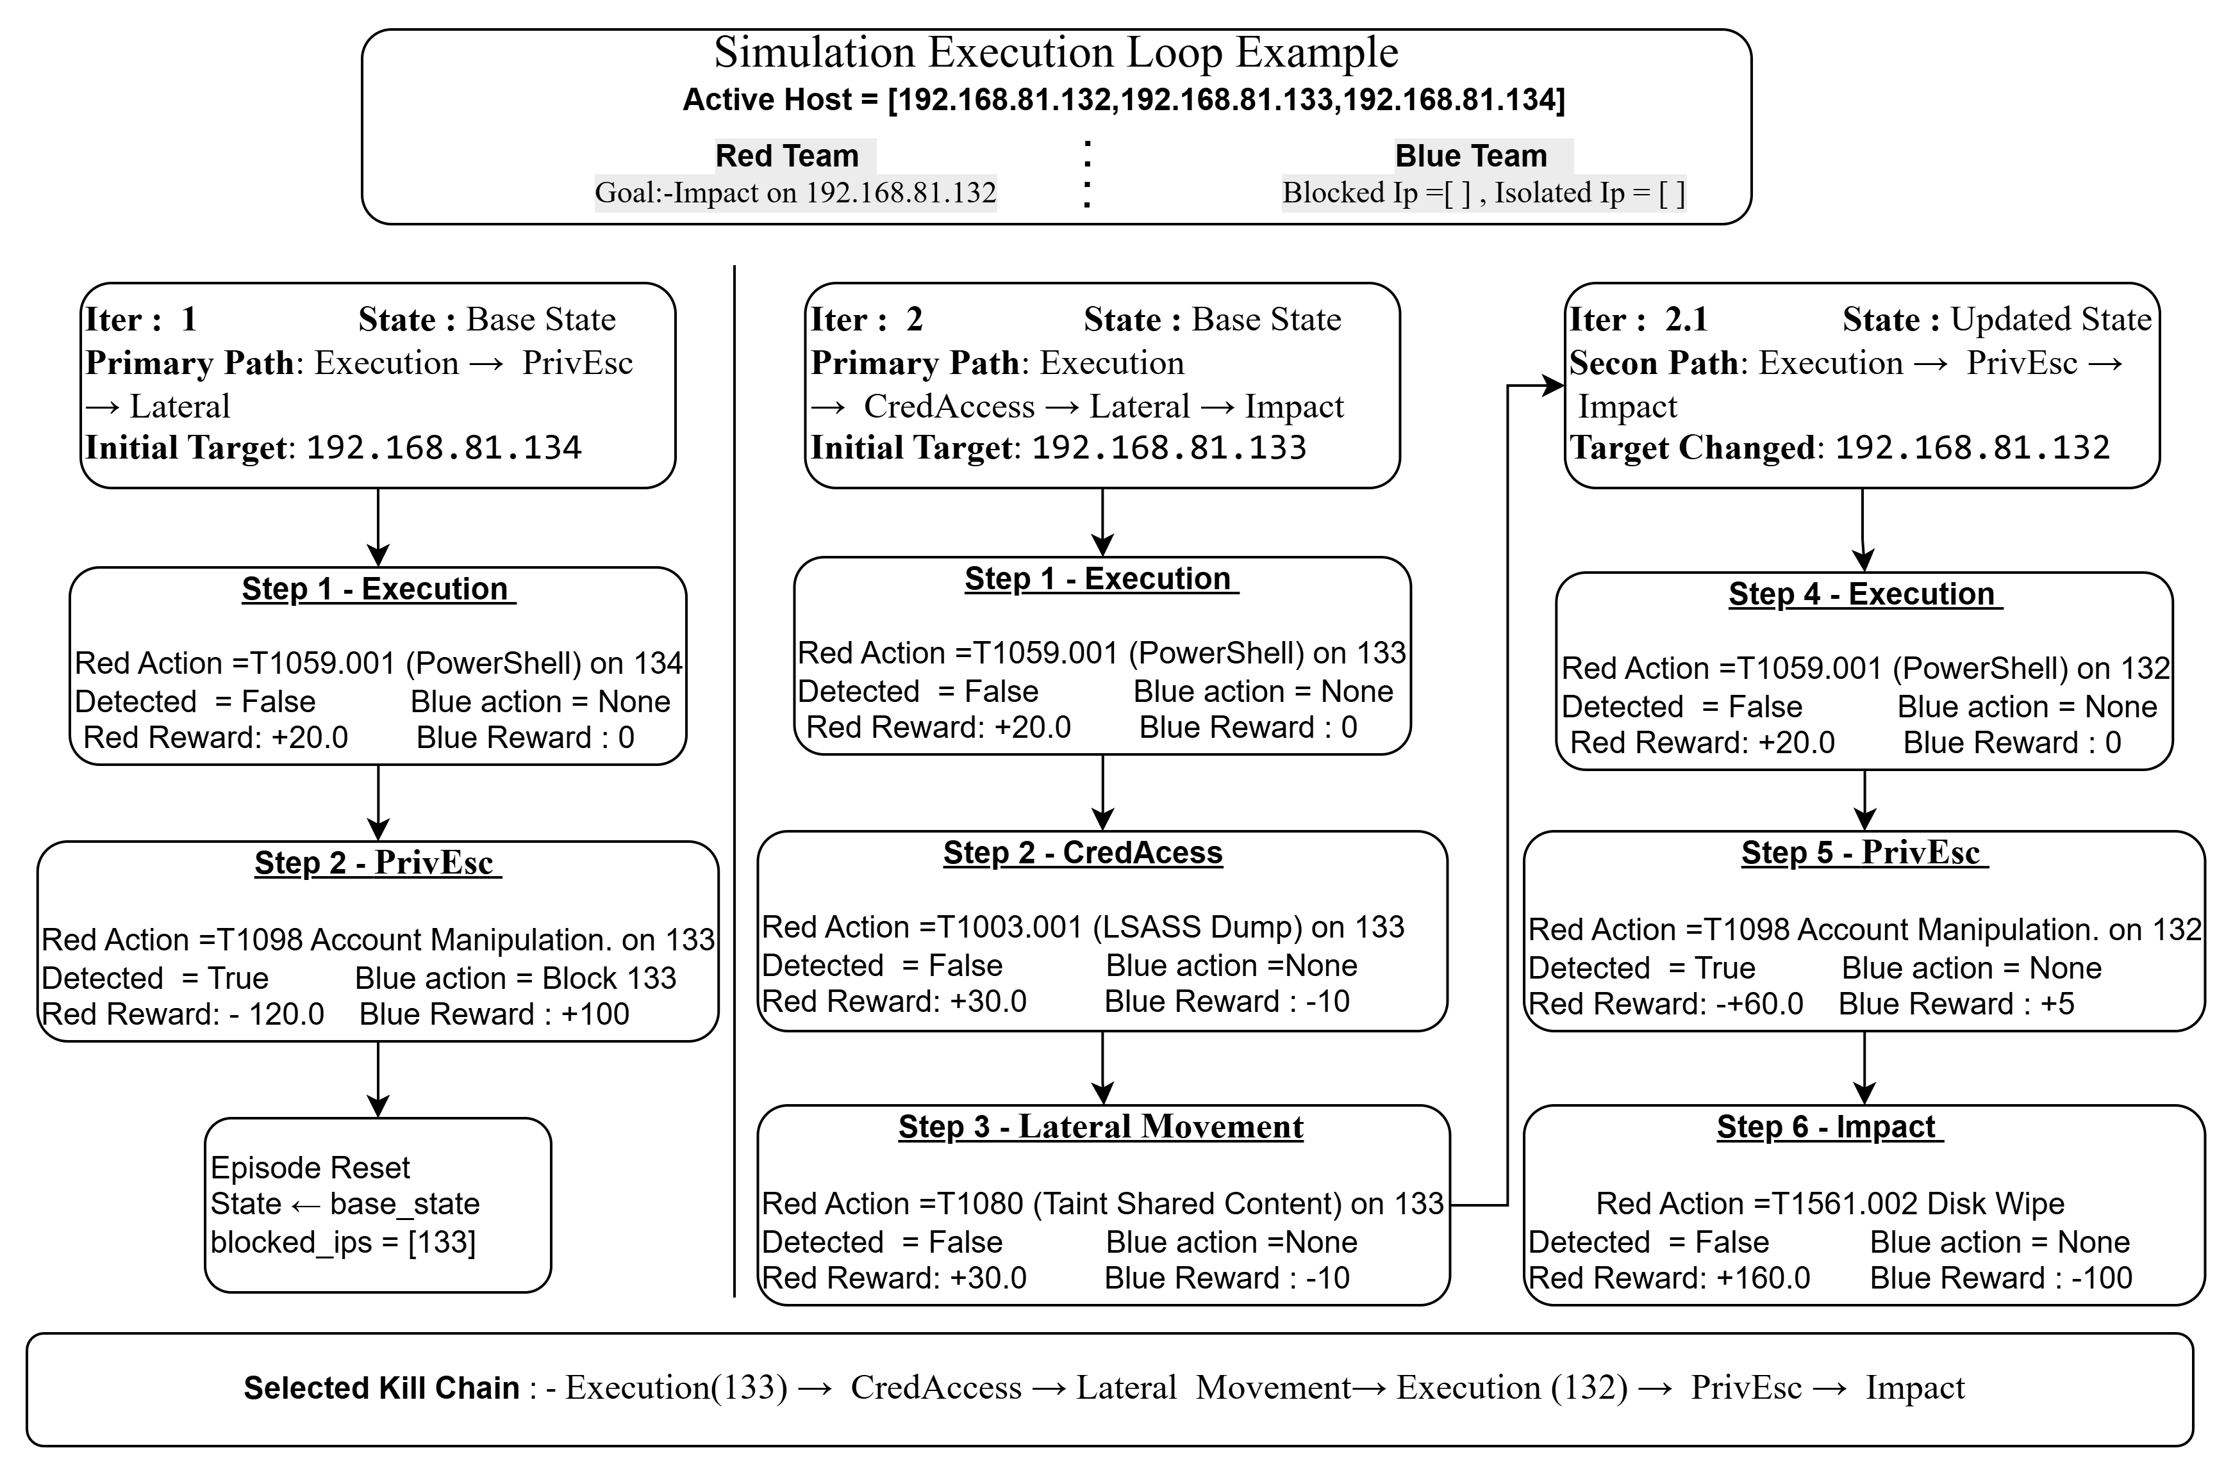
25

Slide 26
Problems - RL + LLM Red Agent
Problem 1: Invalid / missing parameters: many actions require parameters (e.g., ports, exploit IDs, creds), but the agent previously selected only the target IP, causing non-executable actions.
Problem 2: Wasted exploration on impossible actions: The agent selects techniques even if needed conditions (like credentials or open ports) are not met.
Problem 3: Dynamic action space hurts learning: parameters (open ports, available exploits, discovered creds) change over time, making the effective action space unstable and slowing policy learning.
26
Notes:
Critical Infrastructure at Risk: Industrial systems like power grids and water treatment plants face sophisticated threats. Traditional methods can fall short when attackers use zero-day or advanced tactics specifically designed for ICS environments.
Shortcomings of Existing Security: While IDS and static honeypots work in IT contexts, ICS attackers can detect and evade these simpler decoys. Current ICS honeypots exist, but many are static, offering limited engagement and realism.
ICS/OT vs. IT: ICS protocols are not like typical IT protocols; they are often proprietary, binary, and real-time. This difference demands a more specialized honeypot approach. Some ICS-targeted honeypots do exist, but most lack adaptive, learning-based deception techniques.
Need for Innovative Defense: An RL-driven honeypot can dynamically respond to attacker behavior, prolong engagement, and provide deeper insight into attacker tactics. This addresses the unique ICS vulnerabilities and helps defenders stay a step ahead.

Slide 27
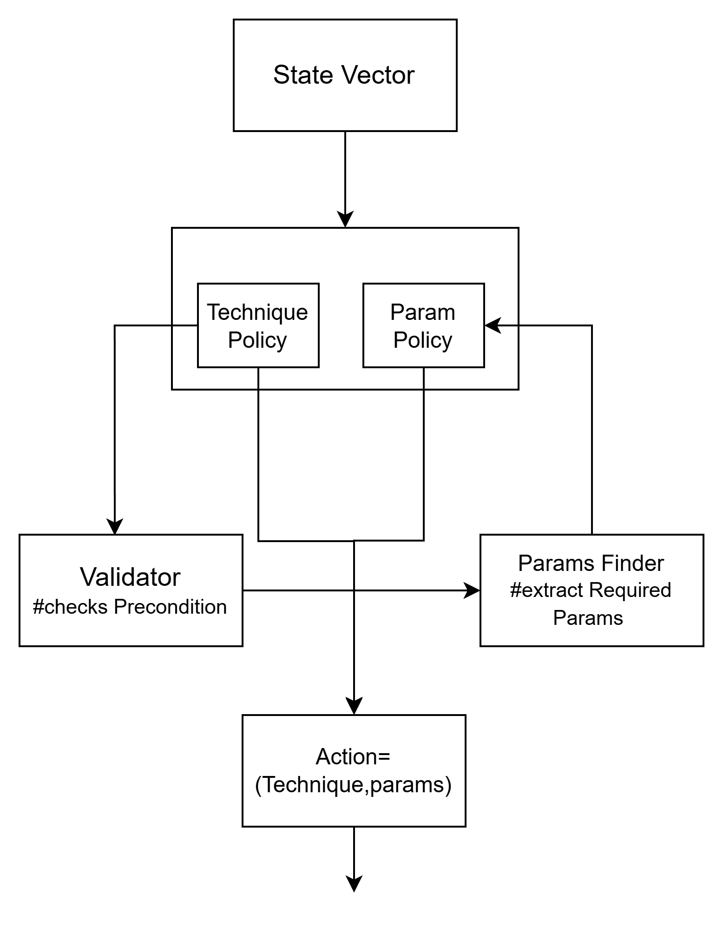
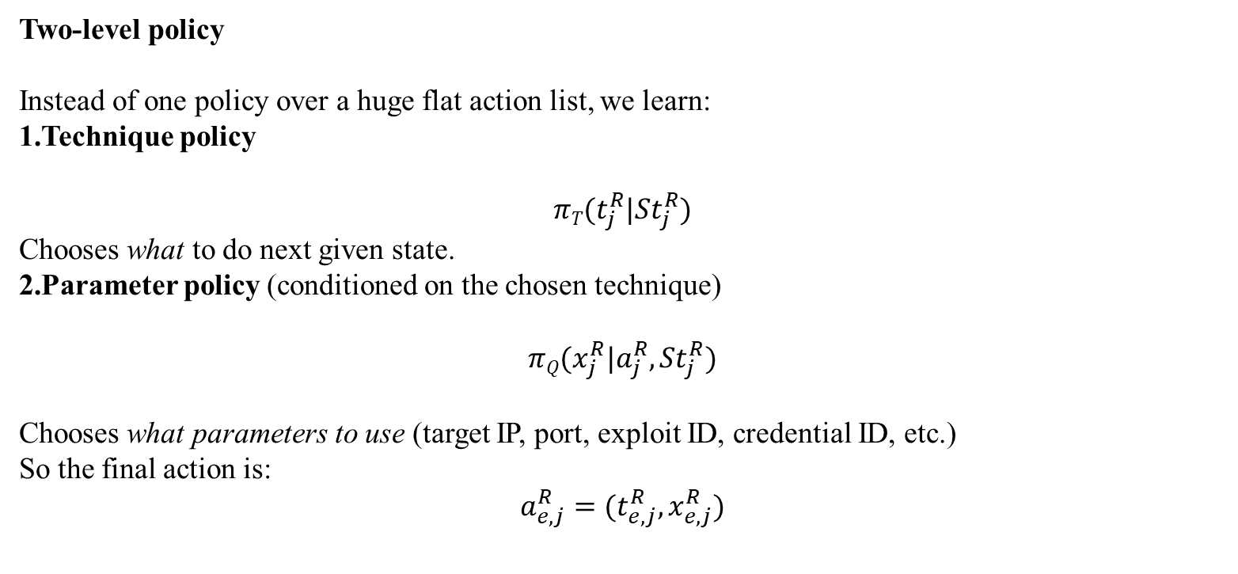
Solution 1 - Parameterized RL [7]
Two-level policy
Instead of one policy over a huge flat action list, we learn:
Technique policy
$$πT(t_{j}^{R}|{St}_{j}^{R})$$
Chooses what to do next given state.
Parameter policy (conditioned on the chosen technique)
$$πQ(x_{j}^{R}|a_{j}^{R},{St}_{j}^{R})$$
Chooses what parameters to use (target IP, port, exploit ID, credential ID, etc.)
So the final action is:
$$a_{e,j}^{R}=(t_{e,j}^{R},x_{e,j}^{R})$$
27
Notes:
Critical Infrastructure at Risk: Industrial systems like power grids and water treatment plants face sophisticated threats. Traditional methods can fall short when attackers use zero-day or advanced tactics specifically designed for ICS environments.
Shortcomings of Existing Security: While IDS and static honeypots work in IT contexts, ICS attackers can detect and evade these simpler decoys. Current ICS honeypots exist, but many are static, offering limited engagement and realism.
ICS/OT vs. IT: ICS protocols are not like typical IT protocols; they are often proprietary, binary, and real-time. This difference demands a more specialized honeypot approach. Some ICS-targeted honeypots do exist, but most lack adaptive, learning-based deception techniques.
Need for Innovative Defense: An RL-driven honeypot can dynamically respond to attacker behavior, prolong engagement, and provide deeper insight into attacker tactics. This addresses the unique ICS vulnerabilities and helps defenders stay a step ahead.

Slide 28
Solution 3 – Fixed Recon
Fixed Recon-first stage to stabilize future action space:
Recon runs first to populate a richer post-exploitation-ready state vector (ports/services/creds candidates).
This stabilizes parameter candidate sets for later tactics so RL can learn a consistent policy instead of chasing a constantly changing action space.
Recon phase runs first: ActiveRecon → ScanPorts → ServiceDetect → CredDiscovery
State after Recon:
discovered_hosts = {10.0.0.5, 10.0.0.9}
open_ports[10.0.0.5] = {22, 445}
services[10.0.0.5] = {SMB, SSH}
credential_store = {cred_1}
Post-Recon (stable action space)
Exploit_Service parameters are now fixed to valid candidates:
target_ip ∈ {10.0.0.5, 10.0.0.9}
port ∈ {22, 445} (masked per IP)
credential_id ∈ {cred_1}
RL learns a consistent mapping from state → action instead of adapting to a moving parameter space.
28
Notes:
Critical Infrastructure at Risk: Industrial systems like power grids and water treatment plants face sophisticated threats. Traditional methods can fall short when attackers use zero-day or advanced tactics specifically designed for ICS environments.
Shortcomings of Existing Security: While IDS and static honeypots work in IT contexts, ICS attackers can detect and evade these simpler decoys. Current ICS honeypots exist, but many are static, offering limited engagement and realism.
ICS/OT vs. IT: ICS protocols are not like typical IT protocols; they are often proprietary, binary, and real-time. This difference demands a more specialized honeypot approach. Some ICS-targeted honeypots do exist, but most lack adaptive, learning-based deception techniques.
Need for Innovative Defense: An RL-driven honeypot can dynamically respond to attacker behavior, prolong engagement, and provide deeper insight into attacker tactics. This addresses the unique ICS vulnerabilities and helps defenders stay a step ahead.

Slide 29
Implementation- Open-Source Tools and Libraries
Category | Sub Category | Name | Description
TOOLS | Environment / Orchestration | Kubernetes | Container orchestration platform to manage multi-host cyber range, pods, and services.
 |  | Docker | Container runtime used to package and run applications.
 |  | Kubernetes Jobs | Framework for running batch or one-off tasks (e.g., attack simulations, telemetry jobs).
 | Telemetry & Preprocessing | Zeek | Network security monitoring tool that captures and logs detailed traffic metadata.
 | Storage / Observation Space | MinIO | Open-source, S3-compatible object storage system.
 |  | Parquet | Columnar data storage format optimized for analytics and ML pipelines.
Python Libraries | RL / AI Frameworks | PyTorch | Deep learning framework used for reinforcement learning agents (red/blue team).
 | LLM | ChatGPT API (OpenAI) | API access to large language models for code generation, inference, and mapping techniques.
 | Feature Engineering | Pandas | Python library for data manipulation and feature engineering.
 |  | NumPy | Core numerical library for fast array computations, often used before Pandas/ML.
29

Slide 30
Implementation- Modules
Module | Responsibility
state_persistence.py | Loads, updates, saves, and resets the base world state.
technique_loader.py | Loads, validates, and indexes the technique schema catalogue.
technique_validator.py | Checks schema preconditions and returns feasible techniques and targets.
technique_selector.py | Implements the Red path selector, target selector, state encoder, and technique-selection DDQN.
param_selector.py | Resolves required technique parameters using state lookup and a tabular parameter-selection policy.
blue_detection_agent.py | Encodes logs and implements the Blue detection classifier.
blue_response_agent.py | Implements evidence-gated Blue response selection and the response action-value policy.
reward_calculator.py | Computes Red rewards, Blue detection rewards, Blue response rewards, and terminal rewards.
experiment_config.py | Stores training, evaluation, promotion, exploration, and reset parameters.
30

Slide 31
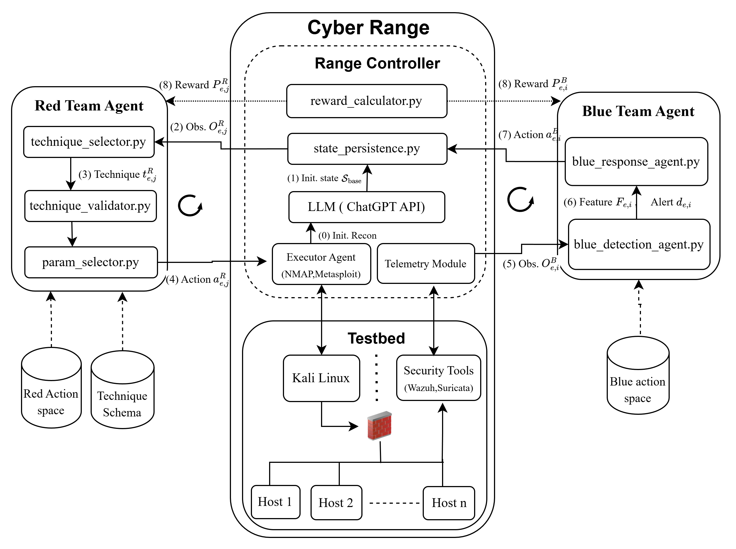
Implementation - System Architecture
31

Slide 32
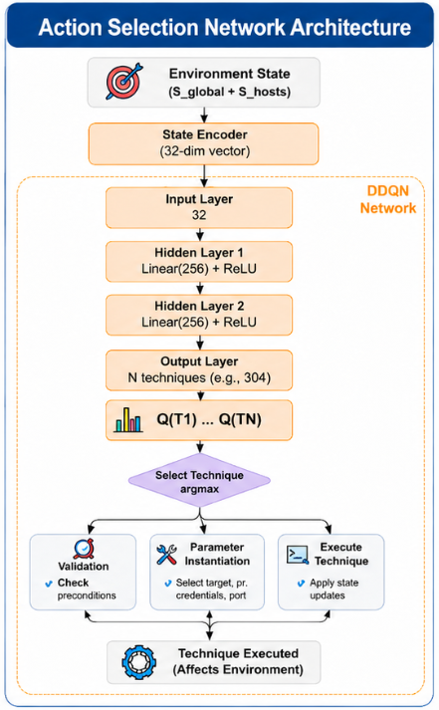
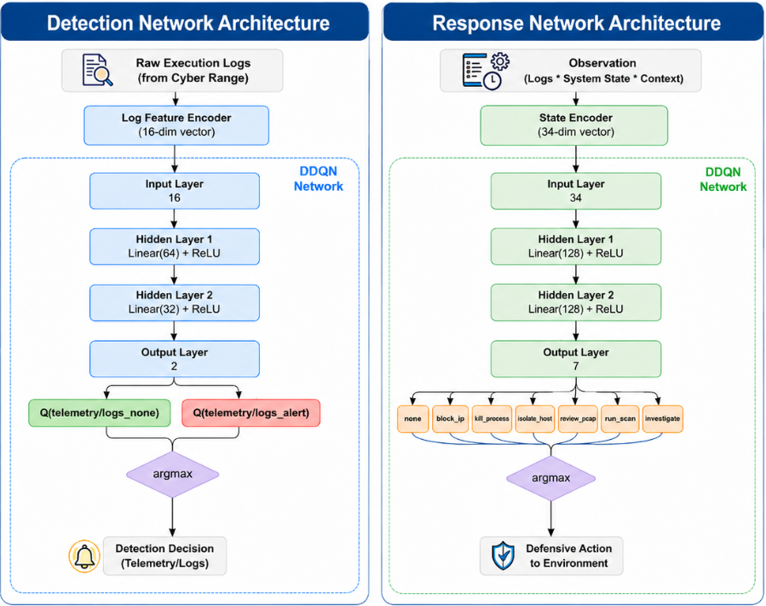
Implementation - System Architecture
(a)
(b)
(c)
32

Slide 33
Issues
Multi-Generation Evolution
How defense performance changes as generations increase.
Cross-Generation performance
How well does a new generation agent generalize when facing different-generation adversaries? (e.g., how Blue Gen-1 perform against Red Gen-3)
Simultaneous Co-Evolution vs Alternating Co-Evolution vs Fixed opponent Training
Does joint co-evolution (alternate Red ↔ Blue updates) lead to more robust agents compared to training Red and Blue independently i.e Fixed opponent?
33

Slide 34
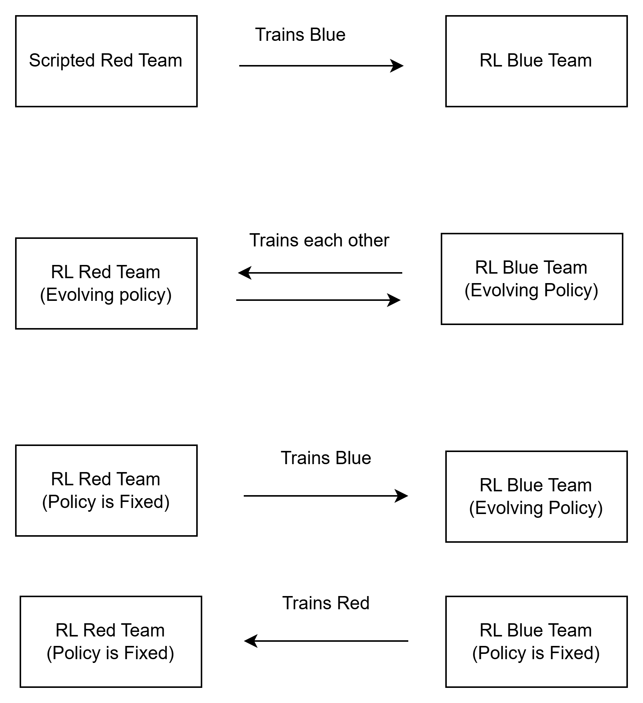
Experimentation Setup
Setup | Red Agent | Blue Agent | Learning Setup | Episodes
1. Fixed Red vs Learning Blue | Fixed scripted attack policy (MITRE sequence / predefined attack chain) | RL + LLM based defensive agent | Only Blue learns. Red behavior does not change. | Until convergence or performance threshold
2. Simultaneous Co-evolution SCE (Red ↔ Blue) | RL/LLM agent that evolves each Episode | RL/LLM agent that evolves each Episode | Both agents learn simultaneously and adapt to each other | ~2000 episodes
3. Alternating Co-evolution CE | One agent fixed policy (trained model from previous generation) | Other agent continues learning | One side evolves while the opponent remains static | ~2000 episodes
34

Slide 35
Evaluation
Intra-Setup Performance: ACE
Does each setup improve over its own generations?
Multi-Gen Evolution: Does Blue suppression ↑ each gen against a stronger Red? → Track suppression rate Gen1→Gen3 per setup
Cross-Gen Performance: Do agents generalize beyond their trained opponent? → Evaluate every Blue gen × every Red gen; measure performance gap vs unseen opponents
Inter-Setup Performance: ACE vs FOT vs SCE
Which training setup produces the most robust agents?
Setup Comparison: Does co-evolution outperform fixed/simultaneous training? → Fix Red opponent; compare ACE_RF vs SCE vs FOT suppression at matched gen
Behavioral Diversity: Does co-evolution produce richer defense strategies? → Compare action type distribution & kill chain length across all setups vs same Red opponent
35

Slide 36
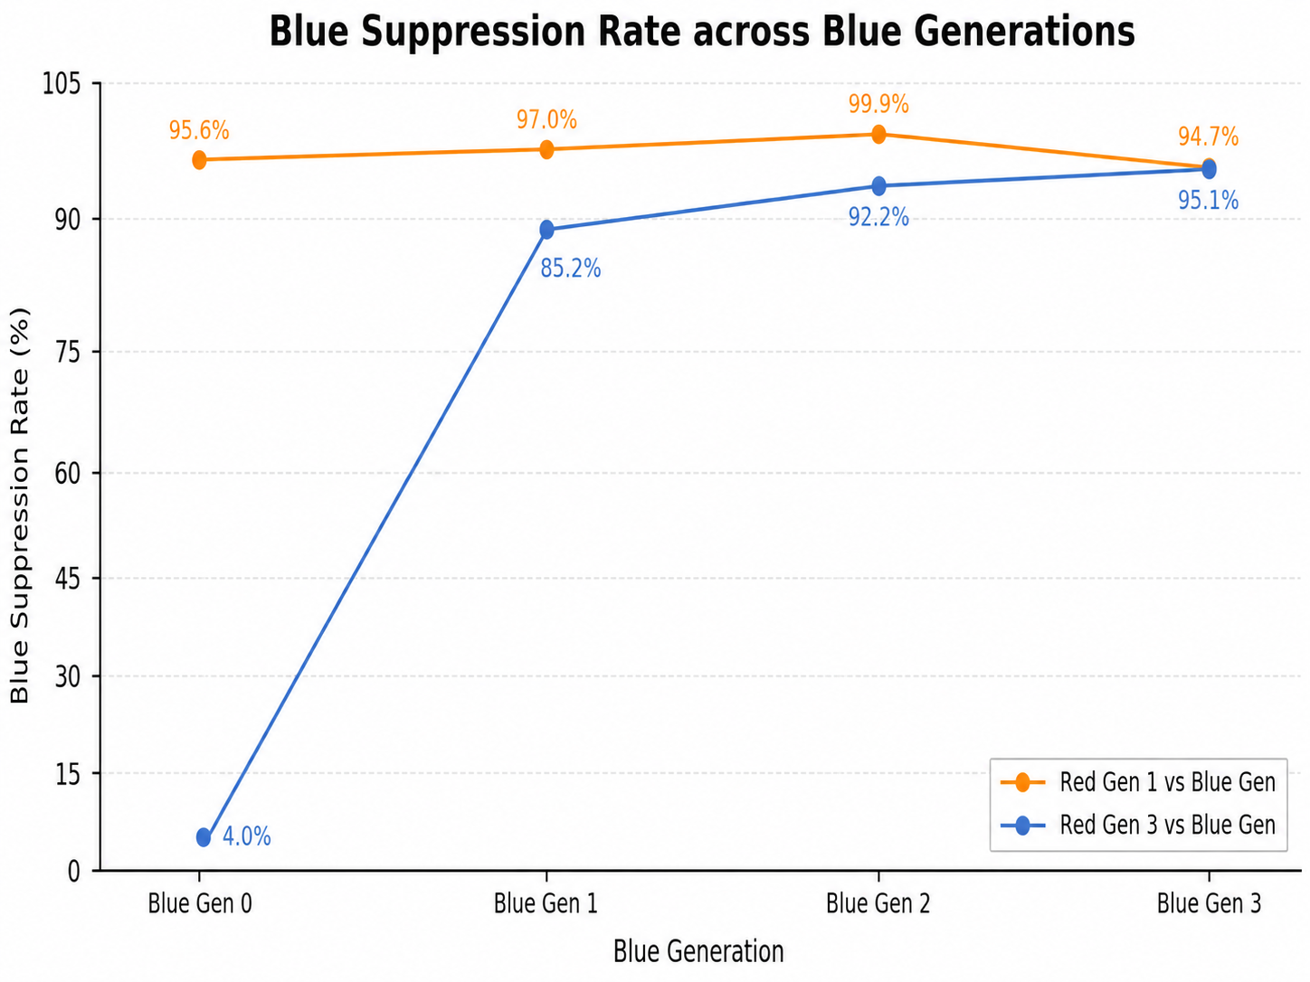
Intra-Setup Evaluation : Multi-Generation Evolution
Q: Does Blue improve vs stronger Red over generations?
A: Yes — 4%→95.1% vs Red Gen3; ≥95.6% vs Red Gen1
Observation | Why | Implication
vs Red Gen3: 4% → 95.1% (+91.1pp) | Blue Gen0 untrained → each gen more capable | Genuine skill ↑ confirmed vs strong opponent
vs Red Gen1: ≥95.6% flat all gens | Red Gen1 too weak to differentiate Blue gens | Weak opponent = not a meaningful eval benchmark
36

Slide 37
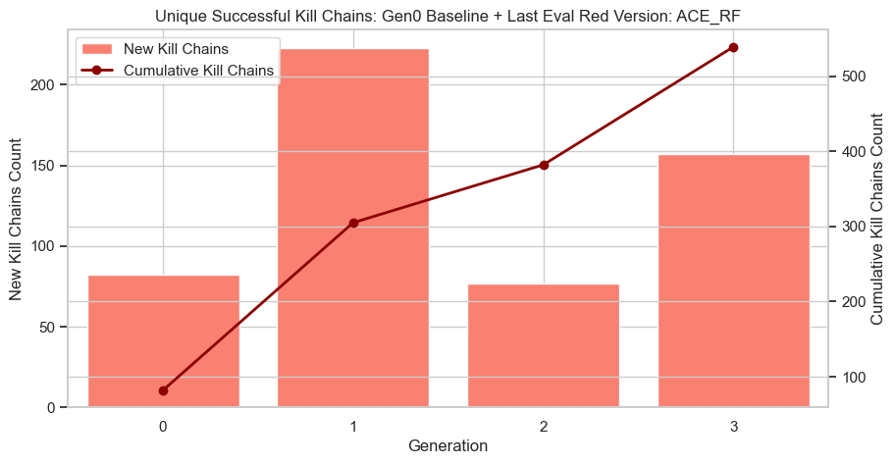
Intra-Setup Evaluation : Multi-Generation Evolution
Q: Is Red continuously discovering new attack strategies across generations?
A: Yes — cumulative kill chains ↑ every gen (→525)
Observation | Why | Implication
New kill chains: Gen0=80, Gen1=222 (peak), Gen2=75 (↓), Gen3=156 (↑); cumulative: →525 | Co-evolution: Blue improves → some Red strategies blocked → Red explores new chains each gen | Red never stagnates; continuously diversifying attack repertoire across training
Cumulative ↑ monotonically (→300→375→525) | Each gen adds unique chains on top of prior; no repetition | Total Red threat surface expands every gen → Blue faces growing attack diversity
37

Slide 38
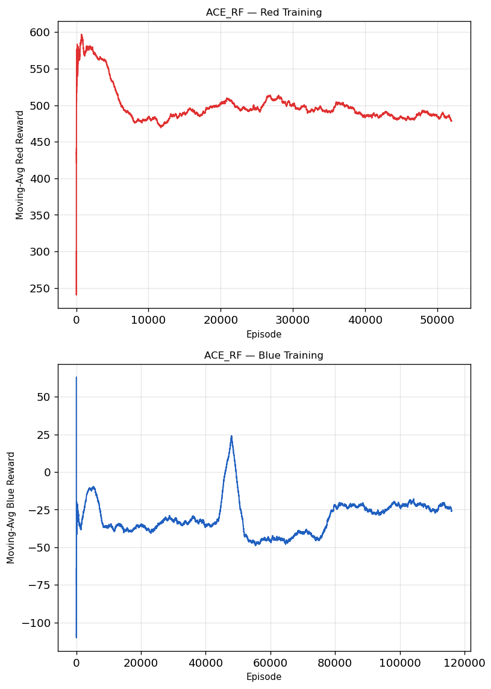
Intra-Setup Evaluation : Multi-Generation Evolution
Q:Do Red and Blue rewards stabilize during training, and what do generational transitions reveal?
A: Yes — both converge to stable plateaus; dips/spikes at gen changes show cost of adaptation but confirm multi-gen co-evolution benefit.
Observation | Why | Implication
Red: spike ~600 → dip ~475 → plateau ~490–510; Blue: dip ~-110 → stabilizes ~-25; sharp disruptions at gen boundaries | Gen change = new opponent → temporary destabilization before re-adaptation | Disruptions confirm agents are genuinely responding to opponent upgrades, not overfitting to one policy
Both agents recover & re-stabilize after each gen transition; overall trend → tighter oscillation | Co-evolution pressure forces re-learning but prior training retained as base | Multi-gen training beneficial → each gen builds on prior; no catastrophic forgetting
38

Slide 39
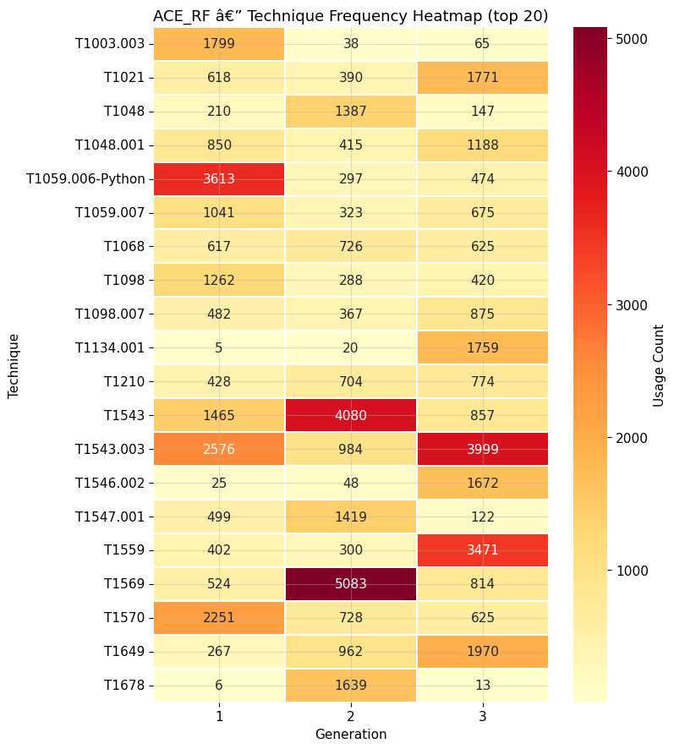
Intra-Setup Evaluation : Multi-Generation Evolution
Q: How Red shift techniques usage across generations?
A: Techniques rotate each gen, confirming strategic adaptation not repetition.
Observation | Why | Implication
Gen1: T1059.006=3613; Gen2: T1569=5083; Gen3: T1543.003=3999 — peaks rotate each gen | Blue suppresses prior dominant techniques → Red shifts strategy | Red adapts per gen; Blue must broaden defense every gen
T1134.001: 5→1759; T1559: 402→3471 — near-zero Gen1 → dominant Gen3 | Red discovers novel paths as Blue hardens | Genuine co-evolution; expanding attack surface each gen
39

Slide 40
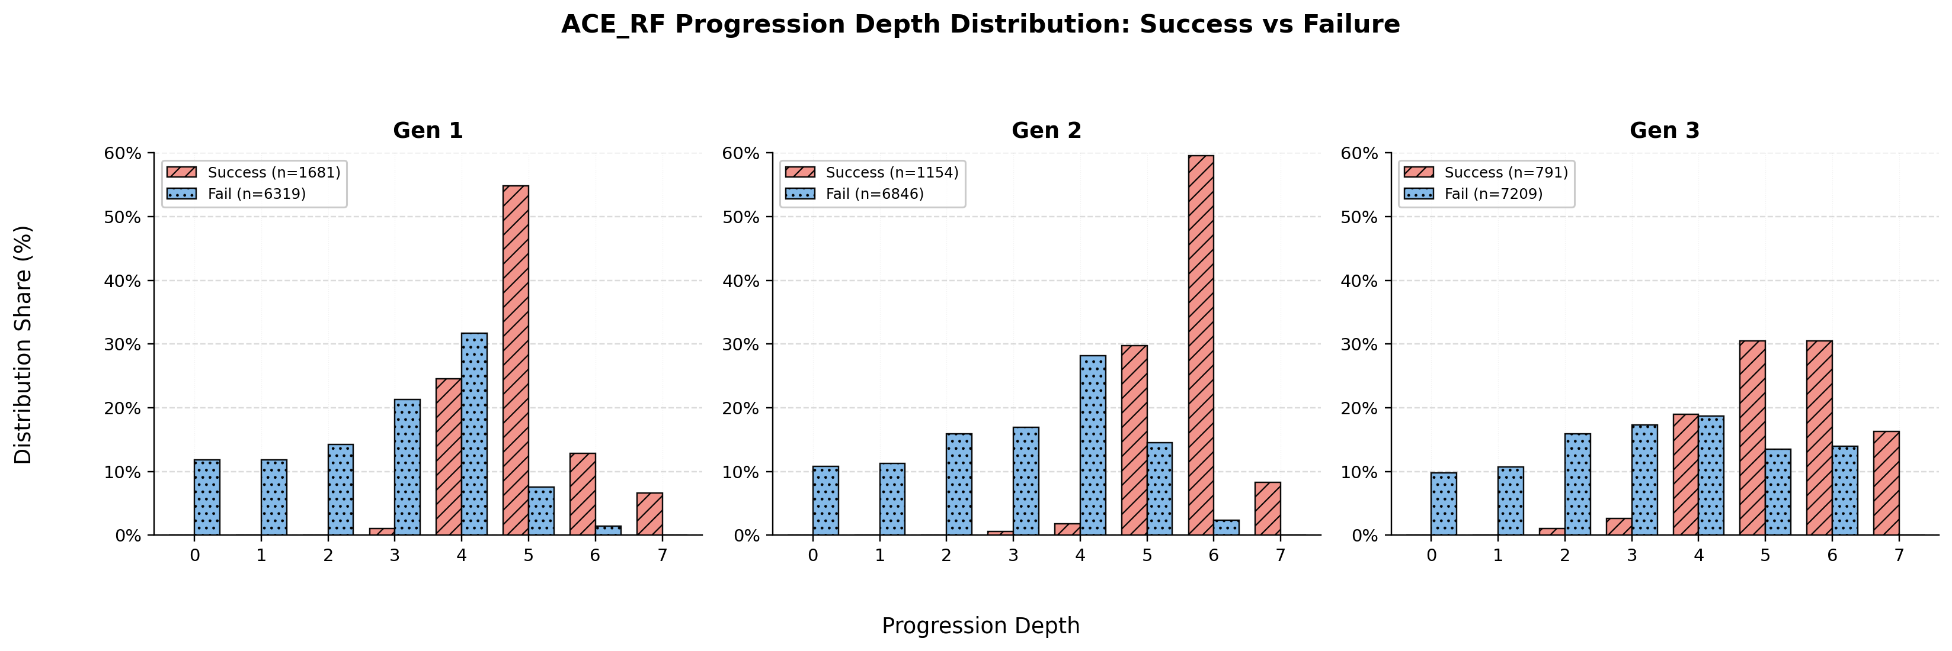
Intra-Setup Evaluation : Multi-Generation Evolution
Q: How Attack Depth vs Success varies across generations
A: Success peaks at deeper depths each gen (5→6→5&7), while failures cluster shallow; Blue forces Red deeper to succeed.
Observation | Why | Implication
Success peak depth : Gen1= 5, Gen2=6, Gen3=5&6 and some 7; failures dominate shallow depths (0–4) all gens; | Blue blocks shallow paths → Red must penetrate deeper to succeed; | Blue defense strengthens each gen; Red forced into longer, harder kill chains to achieve success
Fail n↑: 6319→6846→7209; success rate↓ across gens | success rate ↓ as Blue matures; Co-evolution → Blue increasingly suppresses Red at early stages | Deeper success requirement + fewer successes = Blue genuinely improving, not Red getting weaker
40

Slide 41
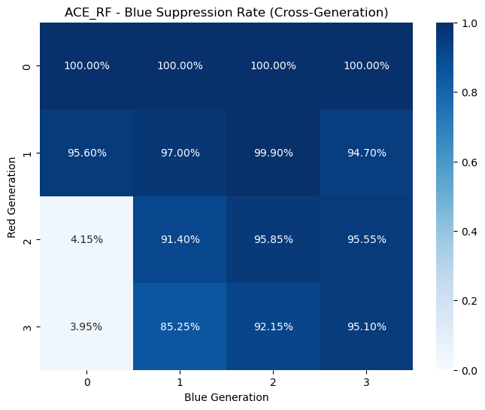
Intra-Setup Evaluation : Cross-Generation
Q: Do co-evolved agents generalize across generation gaps?
A: Blue defense ↑ across rows; Red success ↑ across cols; bidirectional arms race
Pattern | Observation | Why | Implication
Defense row ↑ (left→right) | Blue Gen0 vs Red2/3: ~4%; Blue Gen3 vs Red2/3: 92–95%; row avg ↑ each gen | Each Blue gen trained vs prior Red gens → accumulates knowledge of past attack patterns → defends vs unseen Red | Blue improvement cumulative — later gens carry forward learned history
Attack col ↑ (top→bottom) | Red0=100% all Blue; Red3 col: Blue Gen0=4% → Blue Gen3=95%; upper-right always darkest | Each Red gen learns from prior Blue → progressively sophisticated attacks → older Blue rows cannot fully counter newer Red | Arms race real — Red sophistication genuinely ↑ each gen
41

Slide 42
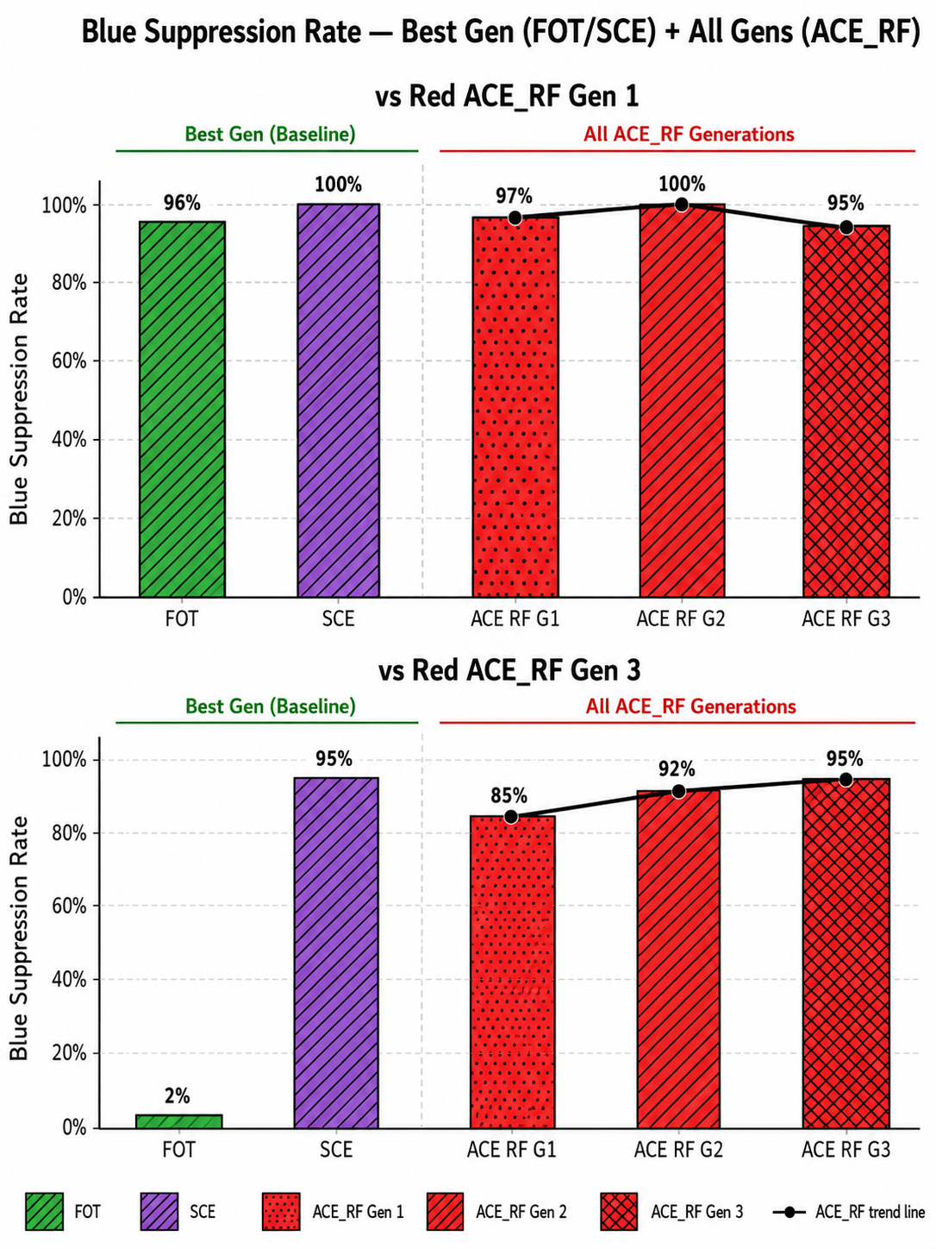
Inter-Setup Evaluation: ACE vs FOT vs SCE
RQ: Does co-evolutionary training (ACE_RF) produce better Blue defense than fixed (FOT) or simultaneous (SCE) training?
A: Yes, FOT collapses vs strong Red (2%), SCE peaks but lacks generalization; ACE_RF all gens ≥85% vs Red Gen3
Observation | Why | Implication
vs Red Gen1: FOT=96%, SCE=100%, ACE_RF G1-G3=95-100% all comparable; vs Red Gen3: FOT=2% (collapse), SCE=95%, ACE_RF G1=85%→G3=95% | FOT Blue trained vs fixed Red → overfits, zero generalization to evolved Red; SCE & ACE_RF face evolving Red → transferable defense | Fixed opponent training = brittle; co-evolution essential for robust generalization
ACE_RF G1=85% → G3=95% vs Red Gen3 (↑ across gens); SCE single best gen=95% but no generational progression | ACE_RF alternating training builds cumulative generational memory; SCE simultaneous training = no staged curriculum | ACE_RF superior consistent ↑ across gens vs SCE one-shot peak; staged co-evolution > simultaneous
42

Slide 43
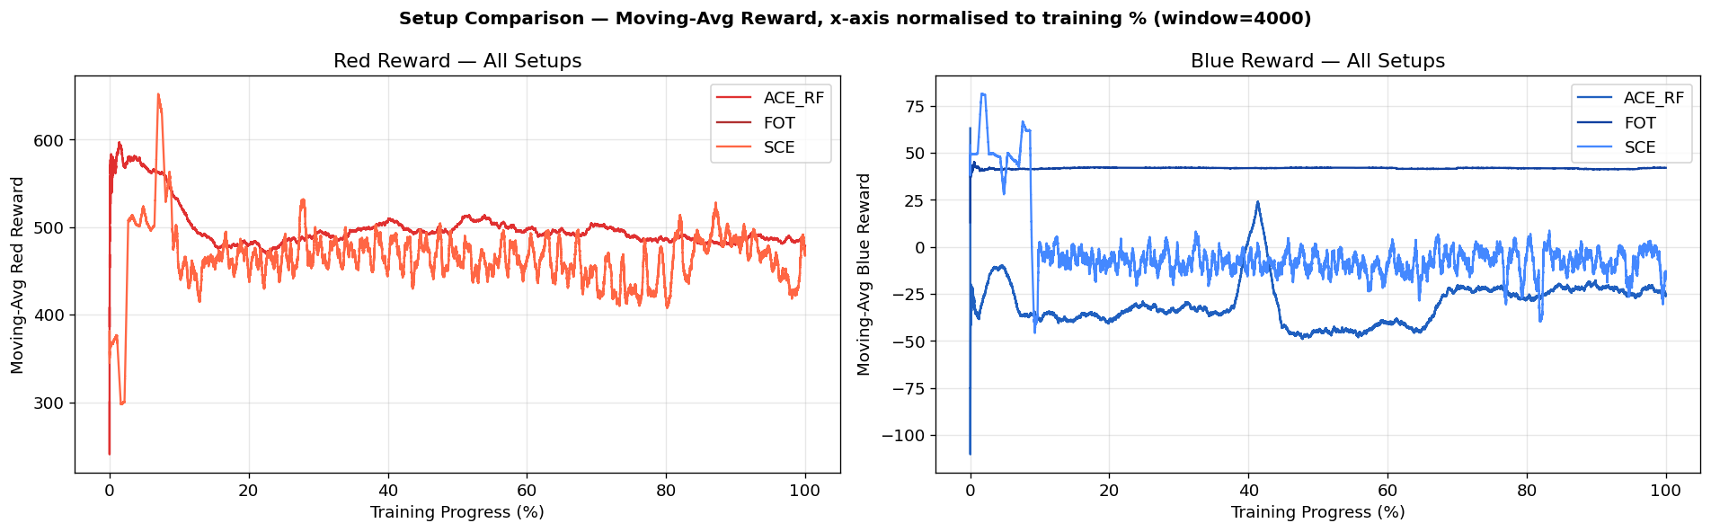
Inter-Setup Evaluation: ACE vs FOT vs SCE
Q: How Reward stability varies across episodes during training in all setups?
A: FOT=false stability, SCE=unstable oscillation, ACE_RF=Adversarial convergence across generations
Observation | Why | Implication
FOT Blue ~+40 (stable); ACE_RF/SCE Blue ~-25; SCE visibly oscillates throughout | FOT=fixed Red→easy rewards; SCE=both policies shift simultaneously→neither stabilizes; ACE_RF=alternating updates→stable convergence | FOT reward=false signal; SCE instability=can't attribute improvement; ACE_RF=reliable training signal
ACE_RF sharp dips at gen transitions (~40%); SCE oscillates entire training; FOT smooth | ACE_RF disruption=new opponent introduced→temporary; SCE disruption=permanent mutual interference | ACE_RF instability bounded & recovers; SCE instability chronic→harder to optimize
43

Slide 44
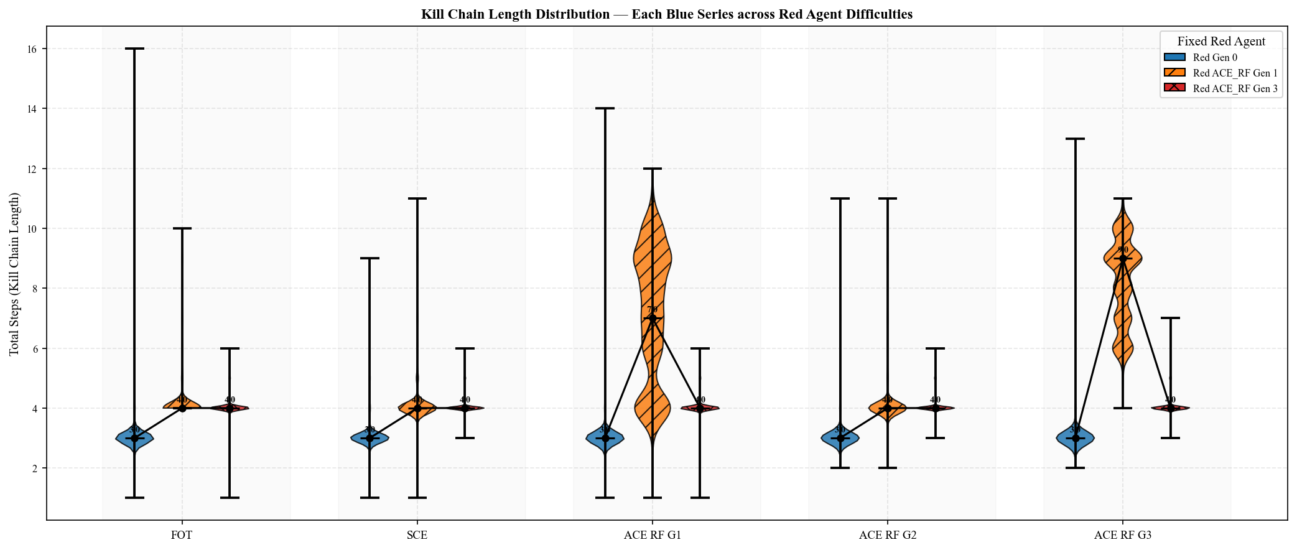
Inter-Setup Evaluation: ACE vs FOT vs SCE
RQ: Does stronger Blue terminate Red kill chains earlier across setups?
A: Shorter chains = Blue stopping Red faster; ACE_RF progressively compresses Red Gen1 chains; Red Gen3 resists compression across all setups.
Pattern | Observation | Why
ACE_RF G1: Red Gen1 violin wide/tall (median~7); FOT/SCE Red Gen1 flat (median~4) | FOT/SCE Blue weak → Red Gen1 stopped early by chance not skill; ACE_RF G1 Blue still learning → Red Gen1 runs longer before stopped | Wider distribution = Blue inconsistent; not yet reliably terminating Red early
ACE_RF G2→G3: Red Gen1 violin narrows & compresses toward median~4; Red Gen3 stays compressed~4 all setups | ACE_RF Blue matures → consistently stops Red Gen1 earlier; Red Gen3 sophisticated → finds short efficient paths, terminated quickly regardless | Compression = Blue improving; short Red Gen3 chains = strong Red evades fast, not Blue winning
44

Slide 45
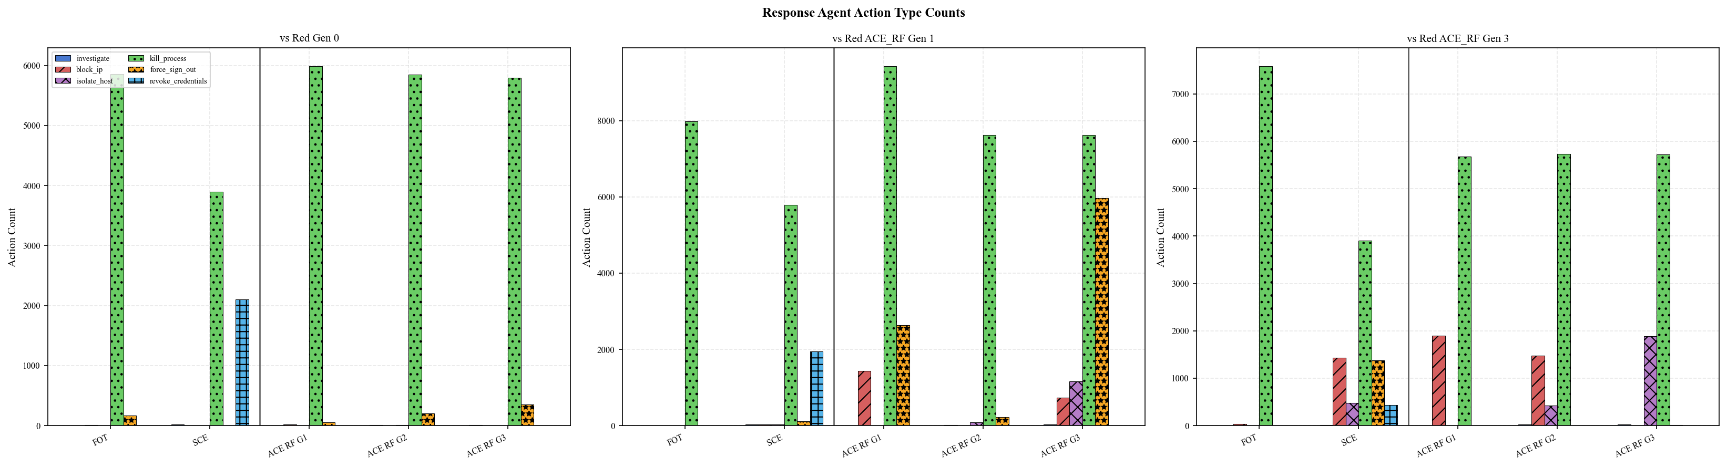
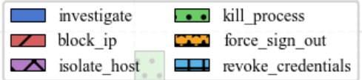
Inter-Setup Evaluation: ACE vs FOT vs SCE
Q: Do different setups produce different Blue defense action strategies?
A: FOT over-relies on kill_process; ACE_RF develops diverse multi-action strategy
Pattern | Observation | Why
FOT: kill_process dominant (~8000 vs Red1; ~7500 vs Red3); all other actions ~0 | FOT Red fixed & weak → Blue learns one effective shortcut; no pressure to diversify | Single-action over-reliance = brittle; collapses vs Red Gen3 (2% suppression)
ACE_RF G3: kill_process~7750 + force_sign_out~6000 + block_ip~1000 + isolate_host~1000 vs both Red gens | Alternating co-evolution → Red adapts → Blue forced to develop complementary action repertoire | ACE_RF Blue = richest action diversity → more robust, adaptable defense strategy
45

Slide 46
Schedule
 | 7 | 8 | 9 | 10 | 11 | 12 | 1 | 2 | 3 | 4 | 5 | 6
Thesis Survey
Proposal Writing
Emulator Setup
Implementation
- Environment Initialization
- Red Team Attack Generation
- Blue Team Detection & Response
- Co-Evolution & Evaluation
Experiment Doing
Thesis Writing
46

Slide 47
References
[1] Valea, Ovidiu and Oprisa, Ciprian, “Towards Pentesting Automation Using the Metasploit Framework,” in 2020 IEEE 16th International Conference on Intelligent Computer Communication and Processing (ICCP), 2020, pp. 171–178.
[2] Red Canary, “Atomic Red Team,” 2024. [Online]. Available: https://atomicredteam.io/
[3] H. P. T. Nguyen, K. Hasegawa, K. Fukushima, and R. Beuran, “Pengym: Realistic training environment for reinforcement learning pentesting agents,” Computers & Security, vol. 148, p. 104140, 2025.
[4] R. Kuppa, S. Poudel, C. E. Hughes, M. F. Alzaben, and P. Tague, “Adversarial reinforcement learning for ransomware attack path generation and defense evaluation,” Apr 2024. [5] R. Castro, S. Ray, R. T. McDonald, and J. Kapoor, “Large language models are autonomous cyber defenders,” May 2025.
[6] H. Emerson, L. Bates, C. Hicks, and V. Mavroudis, “Cyborg++: An enhanced gym for the development of autonomous cyber agents,” Oct 2024.
[7] S. Oesch, A. Chaulagain, P. Austria, B. Weber, A. Sadovnik, C. Watson, M. Dixson, and B. Roberson, “Towards a high fidelity training environment for autonomous cyber defense agents,” in Workshop on Cyber Security Experimentation and Test (CSET), 2024, pp. 1–9.
47
Notes:
Attacker Discovery and Connection:
An attacker discovers the honeypot through network scanning or via exposed services. They might identify what appears to be a vulnerable system through services like HTTP, SNMP, or Modbus exposed by your honeypot setup.
Service Interaction:
The attacker interacts with the exposed services. For example:
HTTP: The attacker might attempt to exploit a web application.
SNMP: They could try to fetch system information.
Modbus: Interaction might involve attempting to command a simulated PLC device.
Scripting and Response Simulation:
Py Scripts: These scripts can be used to automate responses to common queries or actions that an attacker might take, enhancing the realism of the honeypot.
s7comm and snap7 Server: Specifically handle industrial communication protocols, simulating realistic interactions with industrial control systems.
Honeyd and PLC Simulation:
Honeyd: Acts as the primary honeypot daemon, managing and simulating the responses of various network services and devices.
PLC TCP/IP Stack Simulation: Specifically simulates the network stack of a PLC, making it seem as if the attacker is interacting with a real industrial control system.
Data Logging:
Logs from Services: Captures all the interactions at the service level, such as commands issued, responses sent, and any anomalies detected.
Logs from Interaction: Focuses more on the behavior of the attacker, like sequences of actions, times, and potential strategies deduced from their activity.
LLM Agent:
Analyzes the interaction logs using advanced machine learning models to generate insights into the attacker’s methods and objectives.
Potentially adjusts the honeypot’s responses in real-time to continue engaging the attacker or to adapt to new tactics observed.
Security Analysis and Reporting:
All captured data is analyzed to determine the nature of the attack, the potential threat it poses, and the effectiveness of the honeypot’s deception.
Detailed reports can be generated to inform security strategy adjustments and enhance overall defensive measures.

Slide 48
References
[8] L. Li, J.-P. S. El Rami, A. Taylor, J. H. Rao, and T. Kunz, “Cygil: Enabling a network ai gym for autonomous cyber agents,” in International Conference on Computational Science and Computational Intelligence (CSCI), 2022, pp. 172–179.
[9] Strom, Blake and others, “MITRE ATT&CK: Design and Philosophy,” in Technical report. The MITRE Corporation, 2018. [Online]. Available: https://www.mitre.org/ sites/default/files/2021-11/prs-19-01075-28-mitre-attack-design-and-philosophy.pdf
[10] Wiering, Marco A and Van Otterlo, Martijn, “Reinforcement learning,” Adaptation, learning, and optimization, vol. 12, no. 3, p. 729, 2012. 57
[11] W. Masson, P. Ranchod, and G. Konidaris, “Reinforcement learning with parameterized actions,” 2015.
[12] Motlagh, Farzad and Hajizadeh, Mehrdad and Majd, Mehryar and Najafi, Pejman and Cheng, Feng and Meinel, Christoph, “Large Language Models in Cybersecurity: State-of-the-Art,” 2024. [Online]. Available: https://arxiv.org/abs/2402.00891
48
Notes:
Attacker Discovery and Connection:
An attacker discovers the honeypot through network scanning or via exposed services. They might identify what appears to be a vulnerable system through services like HTTP, SNMP, or Modbus exposed by your honeypot setup.
Service Interaction:
The attacker interacts with the exposed services. For example:
HTTP: The attacker might attempt to exploit a web application.
SNMP: They could try to fetch system information.
Modbus: Interaction might involve attempting to command a simulated PLC device.
Scripting and Response Simulation:
Py Scripts: These scripts can be used to automate responses to common queries or actions that an attacker might take, enhancing the realism of the honeypot.
s7comm and snap7 Server: Specifically handle industrial communication protocols, simulating realistic interactions with industrial control systems.
Honeyd and PLC Simulation:
Honeyd: Acts as the primary honeypot daemon, managing and simulating the responses of various network services and devices.
PLC TCP/IP Stack Simulation: Specifically simulates the network stack of a PLC, making it seem as if the attacker is interacting with a real industrial control system.
Data Logging:
Logs from Services: Captures all the interactions at the service level, such as commands issued, responses sent, and any anomalies detected.
Logs from Interaction: Focuses more on the behavior of the attacker, like sequences of actions, times, and potential strategies deduced from their activity.
LLM Agent:
Analyzes the interaction logs using advanced machine learning models to generate insights into the attacker’s methods and objectives.
Potentially adjusts the honeypot’s responses in real-time to continue engaging the attacker or to adapt to new tactics observed.
Security Analysis and Reporting:
All captured data is analyzed to determine the nature of the attack, the potential threat it poses, and the effectiveness of the honeypot’s deception.
Detailed reports can be generated to inform security strategy adjustments and enhance overall defensive measures.

Slide 49
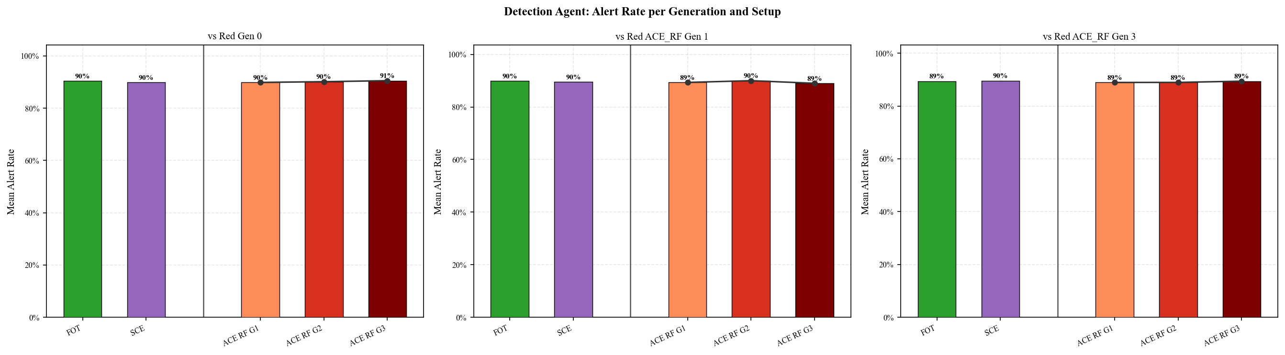
Problem
Next Experiment
Generate quality logs for detector to learn – Maybe from Testbed by executing technique using ATOMIC RED TEAM.
49

Slide 50
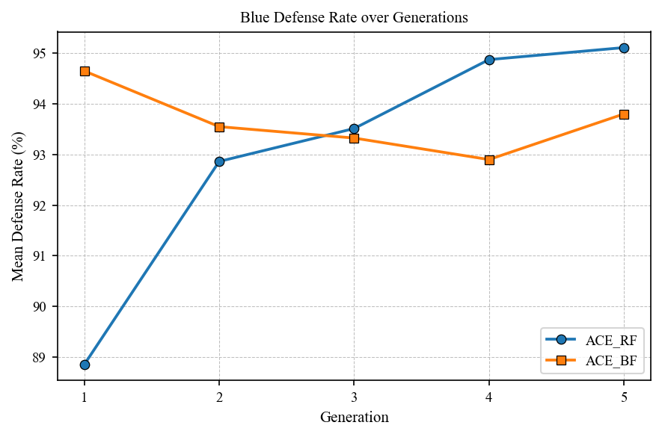
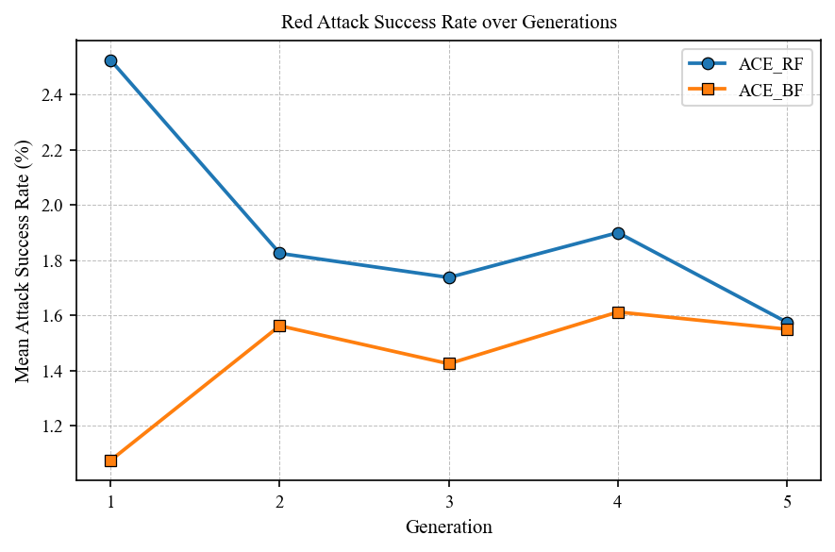
Evaluation : Multi-Generation Evolution
RQ1: Does Blue defense improve consistently across generations?
Observation | Why | Implication
ACE_RF Blue: 88.8% → 95.1% (+6.3pp) ACE_BF Blue: 94.7% → 93.8% (+0.9pp) | ACE_RF Blue trains after Red inherits a harder opponent each generation → forced adaptation ACE_BF Blue starts strong vs weak Red → pressure insufficient for further growth | Adversarial pressure, not early advantage, drives long-term improvement Slow start (ACE_RF) → superior trajectory
ACE_RF Red: 2.5% → 1.6% by Gen5 (−0.9pp) ACE_BF Red: 1.1% → 1.6% (fluctuates) | ACE_RF Red starts high (trains first vs weak Blue) but Blue catches up and suppresses it genuine arms race | Declining Red success = Blue is genuinely improving, not just facing weaker attackers
ACE_RF produces the strongest, most consistent generational growth. Meaningful pressure > early performance.
50

Slide 51
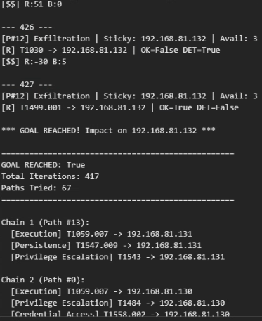
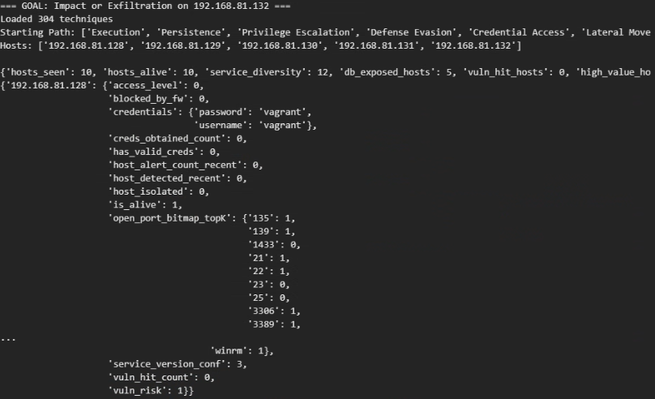
Progress Update (30/1/2026)
Technique schema (Completed) Command database (In progress)
Implemented Co evolution in Simulated Environment. #needs fine tuning
Sequential Kill Chain: Path-based execution instead of random actions.
Target-Specific Goals: High-impact actions restricted to high-value IPs.
Blue Agent Defense: Generate Alerts and Select response Using RL.
Selected Path
State.json
Goal:- Impact or Exfiltration on 192.168.81.131(credentials unknown)
51

